Slide 1
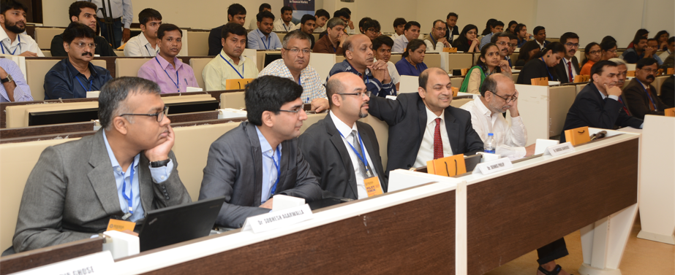

FINANCIAL EDUCATION TRAINING PROGRAM
Creating a financially aware and empowered India.

Slide 2
National Centre for
Financial Education (NCFE)
National Centre for Financial Education (NCFE) is a Section 8 (Not for Profit) Company promoted by Reserve Bank of India (RBI), Securities and Exchange Board of India (SEBI), Insurance Regulatory and Development Authority of India (IRDAI) and Pension Fund Regulatory and Development Authority (PFRDA).
NCFE has been mandated to develop and implement the National strategy for Financial Inclusion (NSFE). This NSFE has been prepared for the period 2020-25
MISSION
To undertake massive Financial Education campaign to help people manage money more effectively to achieve financial well being by accessing appropriate financial products and services through regulated entities with fair and transparent machinery for consumer protection and grievance redressal.
VISION
A financially aware and empowered India.
More info on NCFE and its activites at www.ncfe.org.in

Slide 3

Sessions
Financial literacy Concepts
Banking and Digital Payments
Investment - Stocks, Bonds, Mutual Funds, etc.
Various Financial Inclusion Schemes, Pension Products
Insurance - Products and Services
Consumer Protection and Grievance Redressal
Financial Planning
Implementing Financial Literacy in Schools

Slide 4
Financial Literacy Concepts
1
Importance of financial literacy, Global and Indian scenario and Core concepts to improve your financial skills

Slide 5
Our Perspective
What is financial literacy?
A combination of awareness, knowledge, skill, attitude and behavior necessary to make sound financial decisions and ultimately achieve individual financial wellbeing.
Why financial literacy?
Participation of low income groups in the formal financial system
Increased life expectancy and withering joint family system
Shift in pension from defined benefit to defined contribution
Increase in number and complexity of financial products
Shifting from cash disbursement to Direct Benefit Transfer of social security schemes.

Slide 6
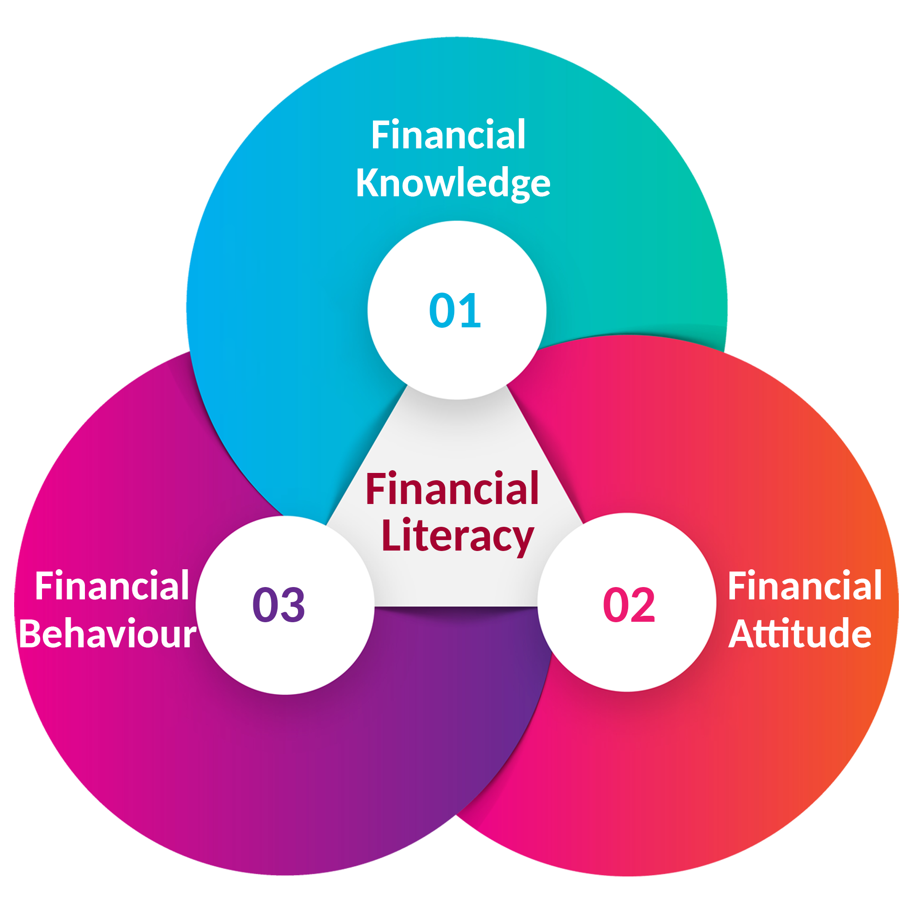

Financial Literacy
It is a combination of Financial
Knowledge, Financial Behaviour, and Financial Attitude necessary to make sound financial decisions and ultimately achieve individual financial wellbeing.

Slide 7

Misconceptions about money
    Money is meant for spending.
    Don’t have enough income to save.
    Insurance is an investment and Term policy is a waste.
    Why bother about pension when my children are doing well.
    Banks ask too many question and will not approve my loan.
    Stock market is too complex for common people to make investment.
    Don’t have enough time to make a plan and invest.

Slide 8

Financial Literacy
Financial Inclusion
Financial Freedom

Slide 9
Core
Concepts
Financial Literacy
Saving and Investment
Three Pillars of Investment
Impact of Inflation
Need vs Want
Time value of money
Power of compounding
Price of procrastination
Rule of 72
Risk vs Return
Diversification

Slide 10

Saving and Investment
Saving is putting aside current earnings
Investment is putting your money to grow
Both are not the same
Saving is a pre-requisite to investment

Slide 11

Useful tips on Saving
Saving is not done once; save regularly
Spend less to save more; record your expenses
Pay yourself first; make a budget
Save to avoid debt; save for emergency & special events
Choose where to save; keep your savings safe
Set savings goals; start saving now
Encourage children to save; value of money
Make saving easier; set auto tranfer to/from account

Slide 12
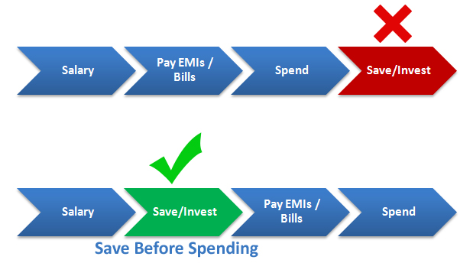
Pay Yourself First

Slide 13
Three Pillars of Investment
Safety
Growth
Liquidity

Slide 14

Inflation & Its impact on savings
* Inflation @ 6% p.a.
What we see in our passbook is called nominal rate of interest. An investor must look at real rate of interest (nominal-inflation).

Slide 15

Nominal vs Real return
Nominal rate is reported or stated
What you see is not necessarily what you get
Nominal rate does not take inflation into account
Real rate is (Nominal rate – Inflation)
An investor must look at real rate of return

Slide 16


Need vs Want
Identify things you don’t need (track your spending)
Before buying ask yourself if you need it
Delay your wants until you can afford them

Slide 17

Need vs Want Matrix
URGENT
IMPORTANT
NOT URGENT
IMPORTANT
Buy now
Plan to buy later
URGENT
NOT IMPORTANT
NOT URGENT
NOT IMPORTANT
Buy if you can afford
Do not buy

Slide 18

Time Value of Money
Why
How
What
A rupee today is worth more than a rupee tomorrow
Inflation, Uncertainty and Opportunity cost
Present and Future Value are linked by a formula
FV = PV (1+r)^{n}
Example: Current monthly exp : 30000. assume inflation of 6% p.a. 20 years later it will be Fv = 30000(1+0.6)²⁰ = 96214

Slide 19
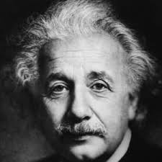
Compound interest is the eighth wonder of the world. Those who understand it, earn it;
those who don’t, pay it.

Slide 20
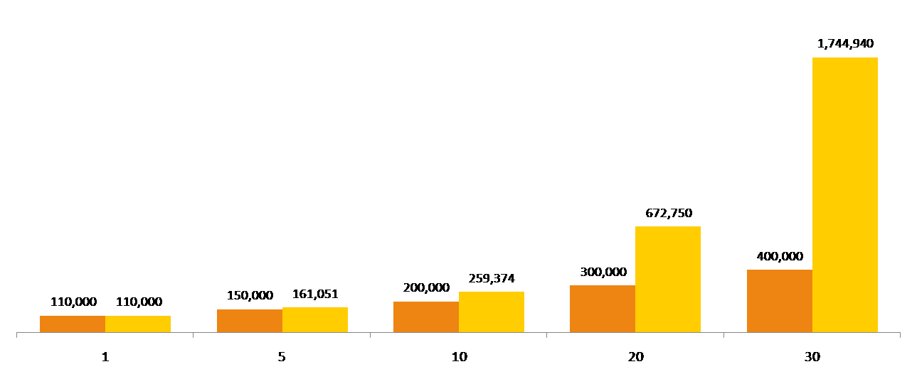
Power of Compounding
Principal amount Rs. 1,00,000/-
Interest @10% per annum
It works best in long-term

Slide 21

Price of Procrastination
Delay in investing because your income is too low is a fallacy
Small amount of investment is more than made up by longer time period
Magic of compounding ensures that small sum grows into a bigger amount over long term

Slide 22
Delay in Investing can be Costly
If you invest Rs. 5000/- per month
At 12% annual return
Your corpus after 30 years
CORPUS IS SMALLER BY
1.77 cr
1.22 cr
95 lakh
50 lakh
55 lakh
82 lakh
1.27 cr
IF YOU START NOW
IF YOU DELAY 3 YRS
IF YOU DELAY 5 YRS
IF YOU DELAY 10 YRS

Slide 23
Rule of 72
How many years it takes for money to double?
72
/
Rate of Interest
=
Number of Years
For Example:
72
/
8%
=
9 Years

Slide 24
Risk vs Return
No such thing as risk free investment.
Risk and return relationship is a tradeoff.
Risk can not be eliminated, but managed.
Manage your risk through diversification

Slide 25

Diversification
Don’t put all eggs in one basket
Diversification is allocating investment in various financial instruments
Goal is to find an appropriate balance between risk and return
Systematic risk like inflation, exchange rate, political instability etc. are not diversifiable

Slide 26
Banking and Digital Payment
2
Saving, transaction and borrowing related prodcuts and services. Use of technology in the banking sector.

Slide 27

A Bank is a financial institution which accepts deposits, facilitates transfer of funds and also lends money to individuals and business firms that need it.

Slide 28
Types of Banks
Banks
Non Scheduled
Scheduled
Payment Banks
Urban
Urban
Commercial
Cooperative
Cooperative
Rural
Public
Private
Foreign
RRBs

Slide 29
Primary Functions
Accepting Deposits
Providing
Credit
Transferring
Money

Slide 30
Accepting Deposits
Banking related products
Current Account
Savings Account
Fixed Deposit
PPF Account
Recurring Deposit

Slide 31

Bank account for Minors
A savings /fixed / recurring bank deposit account can be opened by a minor of any age through his/her natural or legally appointed guardian.
Minors above the age of 10 years may be allowed to open and operate savings bank accounts independently, if they so desire.

Slide 32
Providing Credit
Loans
Borrowing related products
Overdraft
Cash Credit
Credit Card

Slide 33
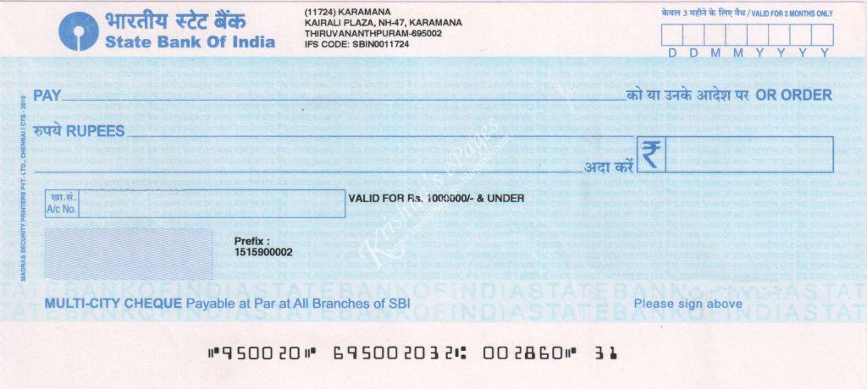
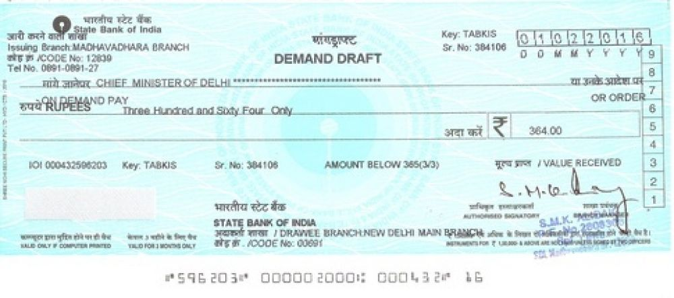
Tranfering Money
Cheque
SAMPLE
Demand Draft
SAMPLE

Slide 34
Cheque and Demand Draft
Key Difference | Cheque | Demand Draft
Payment | Payable to Order or Bearer | Always payable to Order
Issuance | By A/c holders | By Bank
Bank Charges | No | Yes
Dishonour | Yes | No
Facility | Only to a/c holders | For all

Slide 35

Technology and Banking
ATM
Debit Card
Credit Card
Internet Banking
ECS
NEFT
RTGS
IMPS
E-wallets
UPI
BHIM
AEPS

Slide 36
Investment - Stocks, Bonds, Mutual Funds, etc.
3
Investment prodcuts and services. Stocks, Bonds, MFs, EPF, PPF etc.

Slide 37
Financial Market
Money market
Highly liquid
Short-term, under a year
Usually, less risky
High volume
Institutional participation
T-bills, CDs, CPs, etc.
Capital market
Primary and Secondary
Shares
Bonds
Debentures
MFs and ETFs
Forex market
Trading in currecies
Largest in terms of volume
Foreign trade
Hedging

Slide 38
Stock Exchange
A stock exchange does not own shares. It provides a platform to both buyers and sellers of stocks (also known as shares) bonds and other securities. The prices are governed by the forces of demand and supply. It also facilitates issue and redemption of securities as well as payment of dividends.
A stock exchange provides companies with the facility to raise capital for expansion through selling of securities to the investing public.
Primary market
The Initial Public Offering (IPO) of stocks, bonds or other securities are done in this market.
Secondary market
After the IPO, subsequent trading of securities are done in this market.

Slide 39

What is investing?
Investing means putting your money to work for you.
This includes putting money into stocks, bonds, mutual funds, real estate, gold etc.
Investing is not gambling
Benefits of investing is reaped if you stay invested for longer term

Slide 40
Investment Avenues
Stocks
Mutual Funds
Bonds

Slide 41

Stocks
Also known as equity or a share
Part ownership in the company
Returns in the form of dividends or capital gain
Potential for greater returns
Risk of the company not doing well
Price fluctuations (volatility) in short term

Slide 42
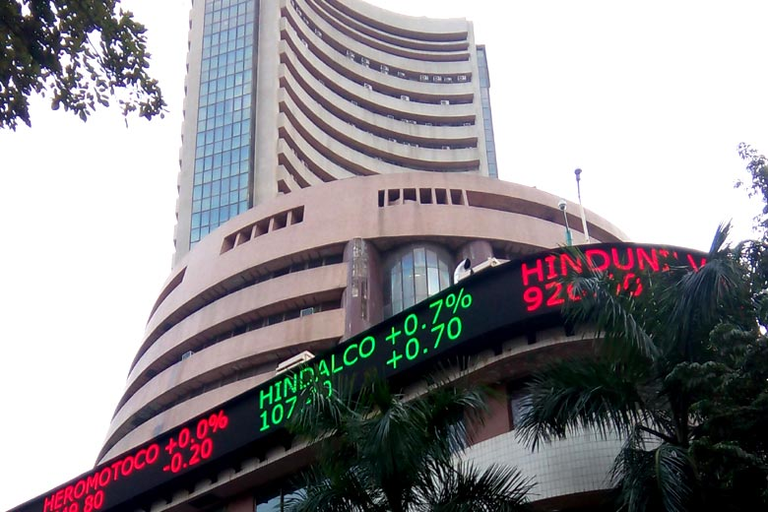
How a stock works?
When you buy a stock, you’re entitled to a small fraction of the assets of that company.
The value of the stock is set by many people trading it in an open market—a stock exchange.
The price of a stock fluctuates according to supply and demand, with many factors influencing these two.
Because so many companies sell stock, the stock market is a very accessible way to invest.

Slide 43

Safeguards
Diversify (company, sector, etc.)
Evaluate and analyze to find a good stock
Understand the stock you are investing in
Take professional help
Invest in stocks via Mutual Fund
Invest with proper knowledge

Slide 44

Mutual Fund
It is a convenient way through which one can invest in most types of assets like stocks, bonds, real easte, gold, etc.

Slide 45
Why Mutual Funds?
Benefits
Professional
Convenient
Economical
Returns based on market performance
Transparent
Diversification
Indirect participation in capital market

Slide 46
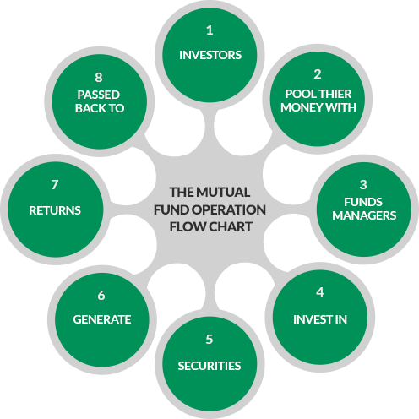
Mutual Fund Operations

Slide 47
How does a Mutual Fund work?
Sponsors
Execute a Trust Deed
to form a trust
Trustees
Investors
Mutual Fund
Investment Management & Day-to-day Operations
Asset Management
Company
Custodian
Agents/
Distributors
Bankers
Fund Accountants
Registrar & Transfer Agency

Slide 48
Types of Mutual Funds
Structure
Management
Objective
Portfolio
Other Funds
Open Ended Funds
Active Funds
Growth Funds
Equity Funds
ETF
Debt Funds
ELSS
Close Ended Funds
Income
Funds
Pension schemes
Passive Funds
Hybrid Funds
Overseas Funds
Interval
Funds
Hybrid
Funds
Liquid Funds
Fund of Funds

Slide 49
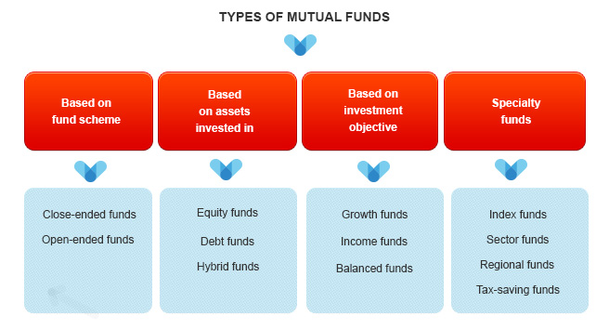
Types of Mutual Funds

Slide 50



Equity Funds
Invests in equities and equity related instruments of companies
Seeking long term growth, but volatile in the short term
Suitable for investors with higher risk appetite and longer investment horizon

Slide 51
Equity Funds Categories
Multi Cap Fund* | At least 65% investment in equity & equity related instruments
Large Cap Fund | At least 80% investment in large cap stocks
Large & Mid Cap Fund | At least 35% investment in large cap stocks and 35% in mid cap stocks
Mid Cap Fund | At least 65% investment in mid cap stocks
Small cap Fund | At least 65% investment in small cap stocks
* Also referred to as Diversified Equity Funds

Slide 52



Debt Funds
Invest in different types of fixed income securities
Aims to earn interest income and capital appreciation
Suitable for investors seeking income at moderate risk

Slide 53
Debt Funds Categories
Overnight Fund | Overnight securities having maturity of 1 day
Liquid Fund | Instruments with upto 91 days maturity
Ultra-Short Duration Fund | Macaulay duration of the portfolio between 3 -6 months
Low Duration Fund | Macaulay duration portfolio between 6-12 months
Money Market Fund | Maturity up to 1 Year
Short Duration Fund | Macaulay duration of the portfolio between 1 year - 3 years

Slide 54
Hybrid Funds
Invest in a mix of equities and debt
Gain from a healthy dose of equities but the debt portion fortifies them against any downturn
Ideal for investors who are looking for a mixture of safety, income and modest capital appreciation

Slide 55
Equity Linked Savings Scheme
Asset Class
Mutual Fund investing more than 65% of its corpus in equities and equity related products.
Benefits
Tax saving u/s 80C up to investment of Rs. 1.5 Lakh
Wealth creation
Choice of Investing
Growth – Profits added back to the value of investment
Dividend – Profits paid out to the investor
Lock in period 3 years
Misc. Features
Minimum investment amount Rs 500

Slide 56
Systematic Transactions
SIP
Systematic Investment Plan is ideal for someone with a goal to accumulate funds for a future goal.
SWP
Systematic Withdrawal Plan is ideal for someone with a lump sum amount to invest for funding regular expenses.
STP
Systematic Transfer Plan is when an investor invests a lump sum amount in a fund and regularly transfer a fixed/variable amount into another fund.

Slide 57
Systematic Investment Plan (SIP)
  SIP is a method of investing a fixed sum, at a regular interval, in a mutual fund scheme
  Similar to monthly saving schemes like a recurring deposit
  Features
    Enables regular investments without any additional paperwork
    Convenient way to invest regularly through one time standing instruction
    Rupee Cost Averaging Benefit to counter volatility
    No timing the market!

Slide 58
SIP chart
SIP of Rs. 5000 MONTHLY @10% RETURN TILL 60.
AGE | AMOUNT | AT RETIREMENT
30 | 18 lakhs | 1.13 Crs
40 | 12 lakhs | 37.97 lakhs
45 | 9 lakhs | 20.72 lakhs
50 | 6 lakhs | 10.24 lakhs
POWER OF COMPOUNDING
https://www.mutualfundssahihai.com/en/calculators

Slide 59
Step up SIP chart
Monthly amount Rs.10000/- ; Step up 10% every year; ROI 8%
AGE | AMOUNT | AT RETIREMENT
30 | 1.97 crs | 4.62 crs
40 | 68 lakhs | 1.29 crs
45 | 38.12 lakhs | 62 lakhs
50 | 19 lakhs | 27 lakhs
POWER OF COMPOUNDING
https://www.piggy.co.in/calculators/step-up-sip-calculator/

Slide 60

Bonds
Bond is a more umbrella term for any type of debt investment.
When you buy a bond, you loan money to an entity; a company or government.
They pay you back over a set period of time with a fixed interest rate.

Slide 61
Characterisitcs of Bonds
Relatively safe and stable
Preservation of capital
Predictable income
Low risk, Low reward

Slide 62
Commodities Markets
is a place where trading in commodities takes place. It is similar to an equity market, but instead of buying or selling shares one can buys or sells commodities.

Slide 63
Types of Commodities
Agro Based
Wheat, Corn, Cotton, Oilseeds, etc
Metals
Aluminum, Nickel, Copper, etc
Bullion
Gold, Silver, Platinum, etc
Crude oil, Natural gas, Gasoline, etc
Soft
Coffee, Cocoa, Sugar, etc
Energy

Slide 64

Purpose and Benefits
Farmers taking advantage of price discovery on futures market
Locking in prices to avoid fluctuations during harvest season
No price manipulation; decided by forces of demand and supply

Slide 65
Insurance - Products and Services
4
Need, importance fundamental principles of insurance

Slide 66

Insurance is one of those things we all should have, but hope we will never need!

Slide 67

Need for Insurance
To protect against loss of income due to accidental death or disability.
To pay for your medical expenses in case of critical illness or unexpected health issues.
To pay for the cost of replacement or repair of your vehicle if you meet with an accident.
To pay for the cost of repair following damage or destruction of your home in fire or flood like incidents.
Financial coverage when you are legally liable to pay for third party injury or damage due to accident.

Slide 68

Concept of Insurance
Group of same risk individuals, agree to share the loss.
Risk is spread in bearable small losses.
Occurrence is random or accidental and not deliberate.

Slide 69
How insurance works?
You take an insurance for your assets or yourself.
Insurer is the company which provides insurance services.
You become a member of the group of same policy.
Insurer compensates you by providing for the loss partly or fully.
You suffer a loss on something you have insured.
You pay a fee (premium) to your insurer to remain a member of the group.

Slide 70

Insurance is a
Risk Management tool.

Slide 71
Fundamental Principles of Insurance
Nature of Contract
Contract between both insurer and insured, entered with free consent.
Insurable Interest
The insured must have an insurable interest in the subject.
Utmost Faith
Both parties should have faith over each other and disclose all information.
Indemnity
Insured would be compensated for the actual loss, not more.
Subrogation
It enables the insurer to claim from third party responsible for loss.
Proximate Cause
When the loss is result of two or more causes, most dominant is considered.

Slide 72
Common Types of Isurance
Insurance
Life
General
Health
Motor
Home
Disability
Travel

Slide 73
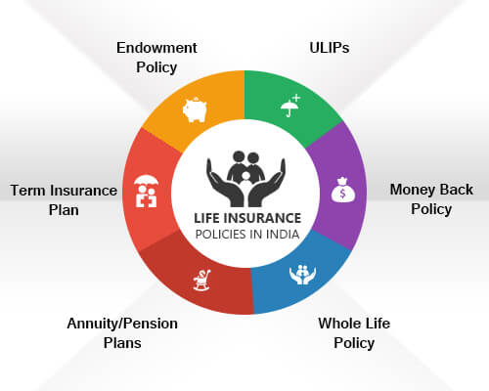
Types of Life Insurance Policies

Slide 74

Term Insurance Plan
Term plans are the most basic form of life insurance.
Provide life cover with no savings / profits component.
Most affordable form of life insurance as premiums are cheaper.
The sum assured is paid if the policyholder expires over the policy term.
If the policyholder survives, there is no pay out.

Slide 75

Whole Life Policy
Validity of the policy is as per the contract period ..
Individual enjoys the life cover throughout his/her life.
Policyholder pays regular premiums until death.
Sum assured is paid out to the beneficiaries.
The policy expires only in case of an eventuality.
Premiums paid under the whole life policies are tax exempt.

Slide 76

Endowment Policy
Endowment plans combine risk cover with financial savings.
Pay out the sum assured and profits under both scenarios; death and survival.
Charge higher premiums.
The profits are an outcome of premiums being invested in asset markets; equities and debt.
Premiums paid under the pure endowment policies are tax exempt.

Slide 77

ULIP
ULIPs are market-linked life insurance products.
Provide a combination of life cover and wealth creation options.
Part of the premium goes toward providing life cover, while the rest is invested in equity and debt instruments.
Individuals can choose the allocation for investments in stock/debt markets.
Useful for achieving various long-term financial goals.

Slide 78

Money Back Policy
It gives periodic payments over the policy term.
A portion of the sum assured is paid out at regular intervals.
If the policy holder survives the term, he/she gets the balance sum assured.
In case of death over the policy term, the beneficiary gets the full sum assured.
The premiums paid and the returns accumulated are tax exempt.

Slide 79

Annuity/ Pension Plans
Financial stability during your old age.
Protect against financial risks as well as provide money in the form of pension at periodic intervals.
Most suited for senior citizens and those planning a secure future.
Premium is to be paid in a lump sum.

Slide 80
Other Important Aspects
Death due to accidents can be covered for additional sum assured.
Policies available exclusively for women & children.
Premium payment options: monthly, quarterly, half yearly, yearly.
Loans available on certain policies, subject to terms and conditions.
Lapsed policies can be revived and also policies can be surrendered before maturity.
The younger you are when you buy, the more cost effective it will likely be.

Slide 81

Motor Insurance
Two types: Liability only and packaged policy.
Packaged policy includes Owners damage along with third party liability.
Third Party Insurance is a statutory requirement.
Compulsory Personal accident cover for owner-driver is also included.
Vehicle owner is legally liable for any injury or damage to third party life or property.
Driving a motor vehicle without insurance in a public place is a punishable offence.

Slide 82

Health Insurance

Slide 83
Various Financial Inclusion Schemes, Pension Products
5
Need and importance. Governemnt focus and the various financial inclusion schemes available for citizens.

Slide 84

Financial inclusion is linked to a country’s economic and social development, and plays a role to connect people with financial services

Slide 85
Being Included Helps
Make day-to-day transactions, including sending and receiving money.
Safeguard savings, which can help households manage cash flow.
smooth consumption and build working capital.
Finance small businesses or microenterprises.
Plan and pay for recurring expenses, such as school fees.
Mitigate risks and manage expenses related to unexpected events.
Improve their overall financial well-being.

Slide 86
Govt. of India Schemes
PMJDY
PMSBY
PMJJBY
APY
SSY

Slide 87
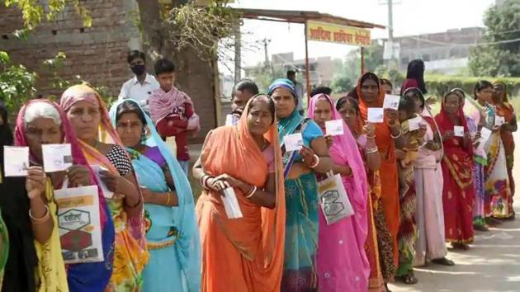
Pradhan Mantri Jan Dhan Yojana

Slide 88
Key Features
No minimum balance required.
Accidental insurance cover of Rs.2.00 lakh
Life insurance cover of Rs.30,000/-
Beneficiaries of Government Schemes will get Direct Benefit Transfer in these accounts.
After satisfactory operation of the account for 6 months, an overdraft facility will be permitted
Can access to Pension, insurance products.
Accidental Insurance Cover, RuPay Debit Card must be used at least once in 45 days.
Overdraft facility upto Rs.10000/- is available in only one account per household, preferably lady of the household.

Slide 89

Pradhan Mantri Suraksha Bima Yojana

Slide 90
Eligibility, Benefits & Termination
People in the age group 18 to 70 years with a bank account can join
Premium of Rs. 20/- per year.
Should give a consent for auto-debit facility
Rs.2 lakh for accidental death and permanent total disability
Rs. 1 lakh for permanent partial disability
Individuals who exit the scheme may re-join the scheme in future years
Policy cover will terminate on attaining age 70 years

Slide 91
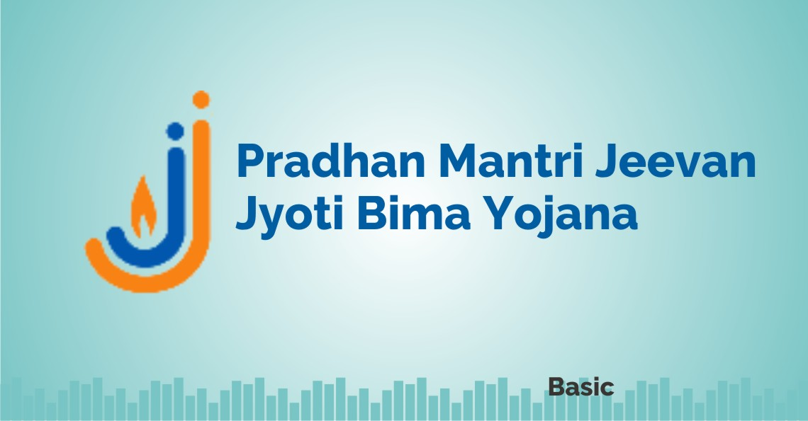
Pradhan Mantri Jeevan Jyoti Bima Yojana

Slide 92
Eligibility, Benefits & Termination
People in the age group 18 to 50 years with a bank account can join
Premium of Rs. 436/- per year.
Should give a consent for auto-debit facility
Rs.2 lakh on policy holder’s death due to any reason
Individuals who exit the scheme may re-join the scheme in future years

Slide 93

Atal Pension Yojana

Slide 94
Eligibility, Benefits & Termination
People in the age group 18 to 40 years with a bank account can join
Defined benefit between Rs. 1000 to Rs. 5000
Guaranteed minimum pension after the age of 60 years until death
Spouse of the subscriber shall receive the same pension until death
After the demise of both, nominee will receive the lump sum amount
Should give a consent for auto-debit facility
Subscribers of Swavalamban in the age group of 18-40 years shall be migrated to APY unless they opt-out
Discontinuing contribution shall lead to account being Frozen, Deactivated and Closed after 3,12 and 24 months, respectively
Premature withdrawal available only in exceptional cases
Option to the spouse to continue contribution to APY on death of subscriber

Slide 95

Sukanya Smariddhi Yojana

Slide 96
Key Features
Account can be opened in the name of a girl child till she attains the age of 10 years
accounts have a tenure of 21 years or until the girl child marries after the age of 18
Only one account can be availed in the name of one girl child
Min Rs. 250 and Max Rs.1.5 lakh can be deposited in a year
Investments upto Rs. 1.5 lakh made in SSY are exempt u/s 80C
The account can be opened by the parent or guardian of the girl child
Once the girl child attains the age 18, partial withdrawals upto 50% are allowed
Payment towards this scheme needs to be made for 14 years
Account can be closed only when the girl child attains 21 years of age
Any kind of withdrawal can be made only by the girl child
Source : http://www.nsiindia.gov.in

Slide 97


It’s never too early to think about Retirement Planning

Slide 98

Pension Products
Pension Funds
(MFs)
EPF
NPS
Pension Plans
(Insurance)
PPF

Slide 99
EPF vs PPF
Particulars | EPF | PPF
Eligibility | Salaried Employees | All Indians, Except NRIs
Interest Rate | 8.10 | 7.10
Tax Benefit | Upto Rs. 1.5 Lakh u/s 80C | Upto Rs. 1.5 Lakh u/s 80C
Investment Period | Upto Retirement or Resignation | 15 yrs, Extendable in 5 yrs block
Premature Withdrawal | Partial withdrawal available | Partial withdrawal available (after 5 years)
Tax on Returns | Tax Free | Tax Free
Loan Options | Yes, only in special cases | Yes, 25% from 3rd yr onward
Minimum Investment | 12% of Basic and DA | Rs. 500/-
Data updated as on 14th September 2021

Slide 100

Features of NPS
All citizens between age 18-70 can open account
Portable across geographies and employment
Low cost, easy to operate
Flexible investment options
Tax benefit to employee and employer
Regulated by PFRDA

Slide 101
NPS Account: Tier I & II
Particulars | Tier I (Pension Account) | Tier II (Investment Account)
Eligibility | All Indians (18-70 years) | Memebrs of Tier I
Bank Account | Not mandatory | Mandatory
Min Contribution To Open | Rs. 500/- | NIL
Min. Contribution per year | Rs. 1000/- | Rs. 250/-
Liquidity | Conditional | Any time
Tax on Maturity | Yes, Conditional | Yes, for Debt Funds
Fund Transfer | Not Possible | From Tier II to I
Tax Benefit | Upto 2 Lakh u/s 80CCD (1 & B) | No

Slide 102
Consumer Protection and Grievance Redressal
6
Financial frauds and consumer awareness, Know the grievance redressal mechanism for different financial sectors.

Slide 103

Know Your Customer (KYC)
KYC enables financial regulators and intermediaries to know their customers.
Understand their financial dealings to be able to serve them better and manage its risks prudently.
To verify the identity of the customer, his address and photograph.
KYC is a regulatory and legal requirement.
Without KYC you can still open a bank account known as ‘Small Account’.

Slide 104

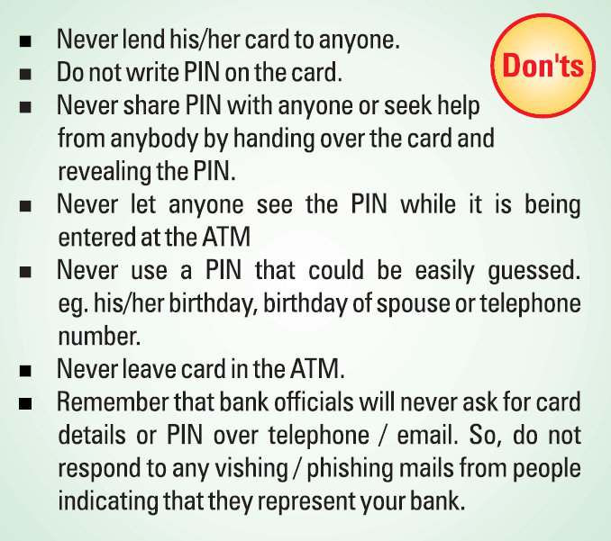
Be Aware: ATM/Debit Card

Slide 105


Be Aware: Frauds and Scams

Slide 106

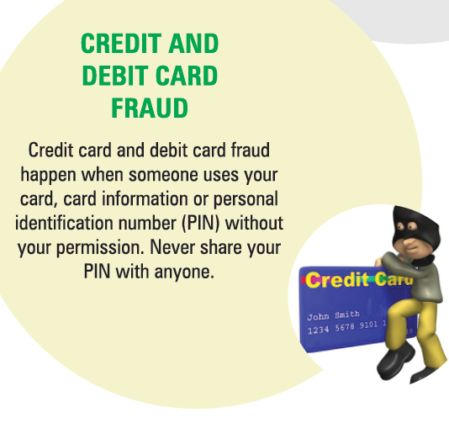
Be Aware: Frauds and Scams

Slide 107
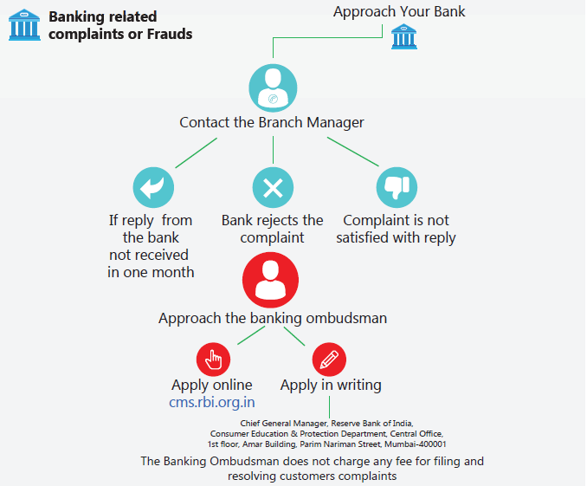
Grievance Redressal - Banking
CMS: Complaint Management System

Slide 108
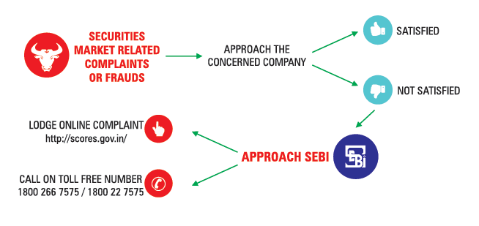
Grievance Redressal - Securities Markets

Slide 109
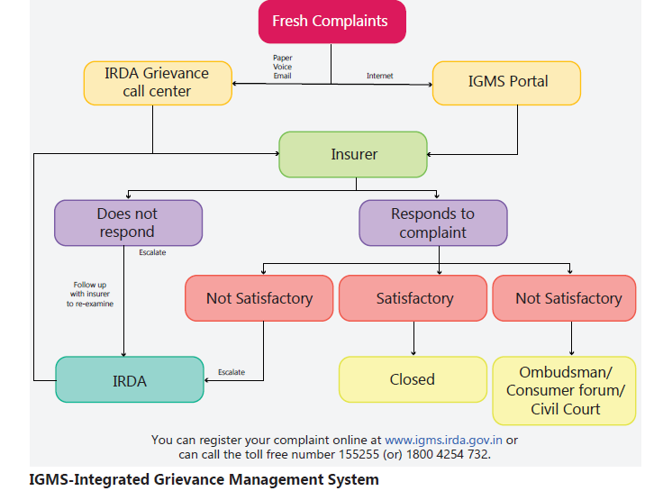
Grievance Redressal - Insurance

Slide 110
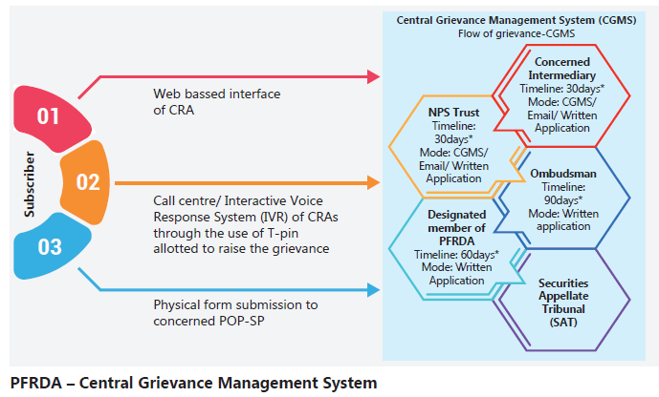
Grievance Redressal - Pension

Slide 111
Financial Planning
7
An overview of the process involved. Case study for creating a retiremnt corpus. Inclusion of Financial Literacy in School Curriculum.

Slide 112

Financial Planning is very important to meet our life goals.

Slide 113

Financial Planning
Financial Planning is the process of meeting your life goals.
Our goals can be met through proper management of your finances.
Life goals can include buying a house, saving for your child's higher education or planning for retirement.

Slide 114
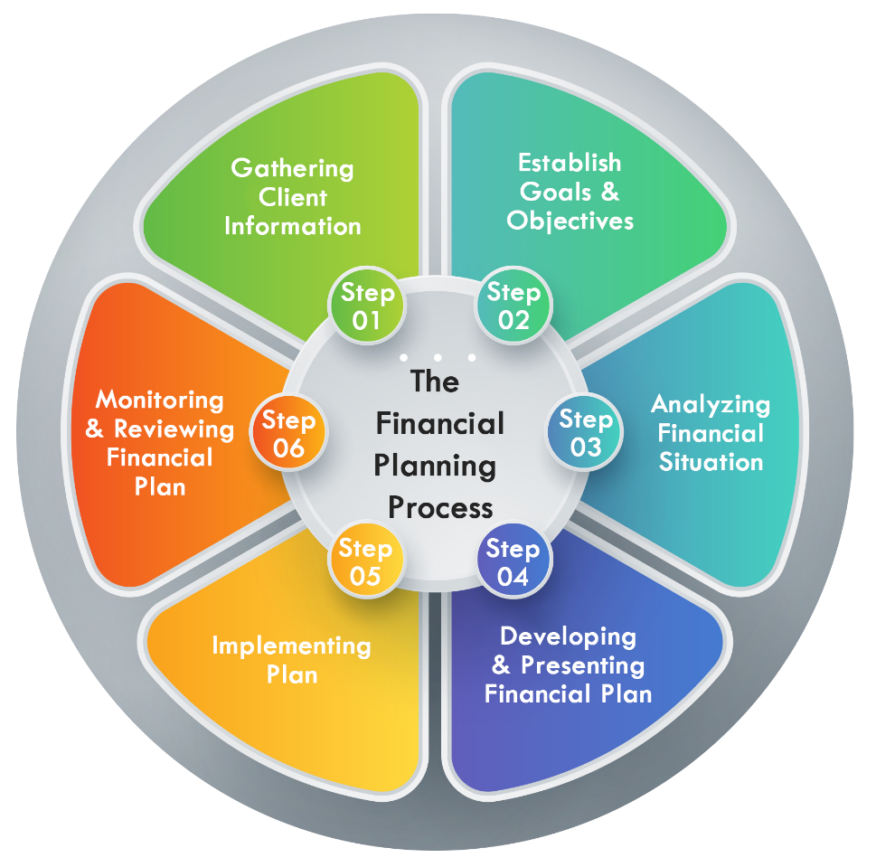
Financial Planning Process
Begin your financial planning by answering 3 questions:
Where am I now?
Where do I want to go?
How do I get from here to there?

Slide 115
Financial Planning Process
1
Consider your skills, education, and interests. All this is tied to your future goals.
2
Identify and establish your financial goals for short, medium and long term.
3
Devise a plan how to achieve your goals. Evaluate alternate plan and select the best plan.
4
Implement the seleted financial plan.
5
Re-evaluate your financial plan as your financial situation or goal may have changed.
6
Revise your financial plan as per your new objectives and goals.

Slide 116

SMART Goals

Slide 117
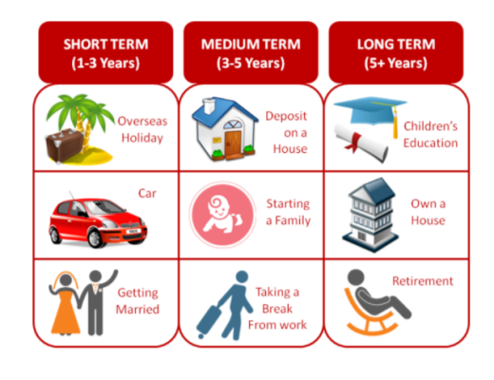
FINANCIAL GOALS

Slide 118
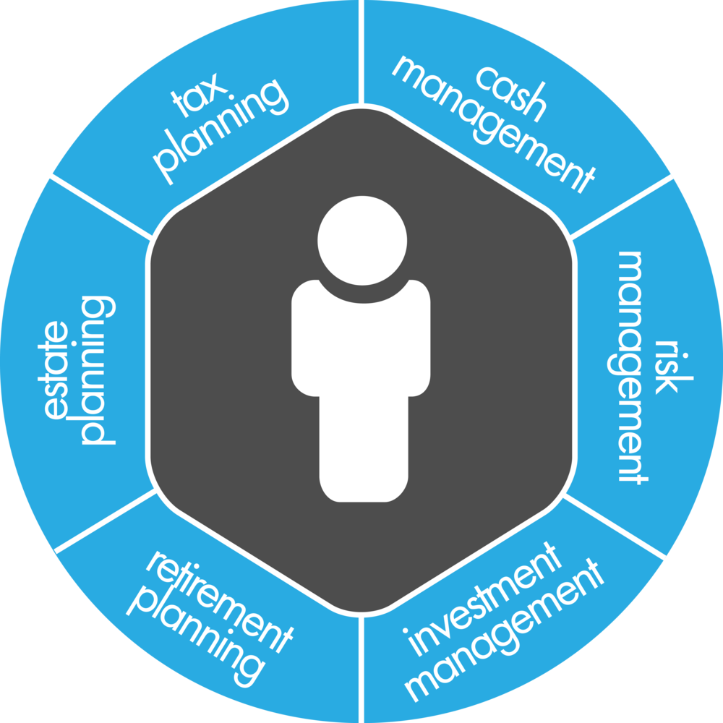
Areas of Financial Planning

Slide 119
Estimation Process
Know your present monthly income and expenditure
Estimate how much income your need per month after retirement
Estimate a corpus that would generate your monthly required income
Calculate how much you need to save per month to be able to build that corpus

Slide 120
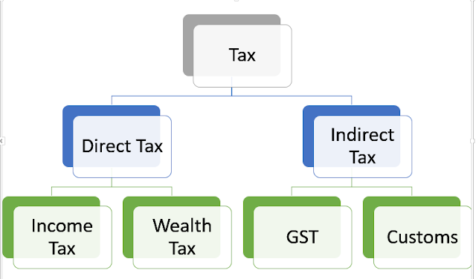
Taxation

Slide 121
Income Tax Returns
Income tax returns are to be filed before 31st July every year. Tax returns for the financial year are to be filed for the financial year, which ends on 31st March. Following information is required for filing income tax returns
  Form 16 – Issued by Employer
  Form 16 A – Issued by entities who have deducted tax at source
  Form 26 AS – Summary of All taxes that has been deducted and credited to PAN

Slide 122

Protect Yourself from FRAUD

Slide 123

Protect Yourself from SCAMS

Slide 124
Implementing Financial Literacy in Schools
8
NCFE provides unbiased financial education in schools for improving financial literacy which is an important life skill for the holistic development of each student.

Slide 125

Implementing Financial Literacy in Schools

Slide 126
Steps for Implementation
Financial Education Training Program
Money Smart School Program
National Financial Literacy Assessment Test

Slide 127

Financial Education for School Students(MSSP)
Financial Education Workbooks (VI - X)
Financial literacy curriculum integrated with the existing subjects for different classes.
This program involve 20 session of 40 minutes each
Certifying schools, as “Money Smart Schools” who voluntarily include NCFE’s financial literacy curriculum in their schools.
School will also be rewarded with Money Smart E – Badge, MSSP Shield and Certificates
Students also will get the certificates

Slide 128
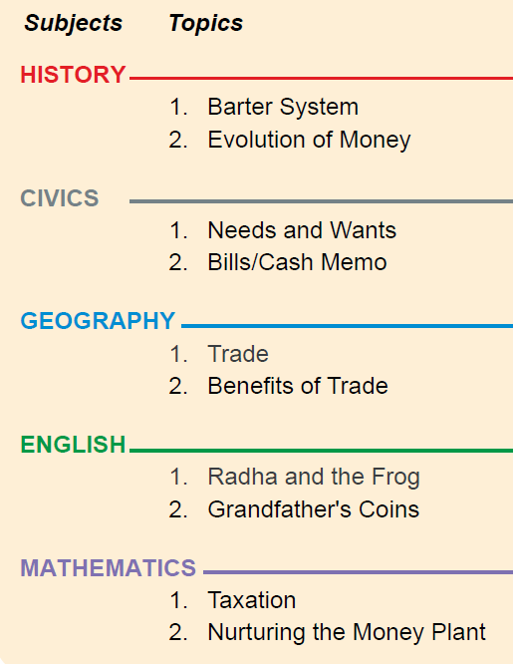
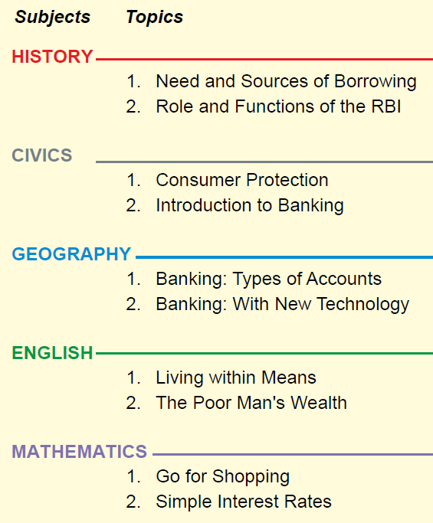
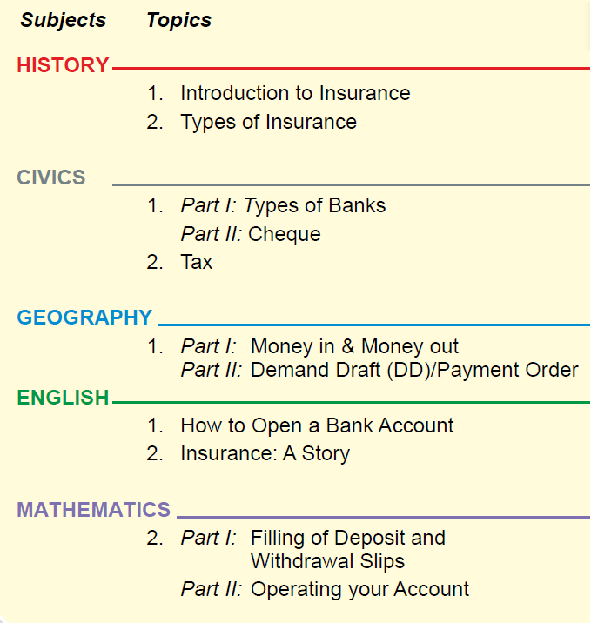
Class VI - Workbook
Class VII - Workbook
Class VIII - Workbook

Slide 129
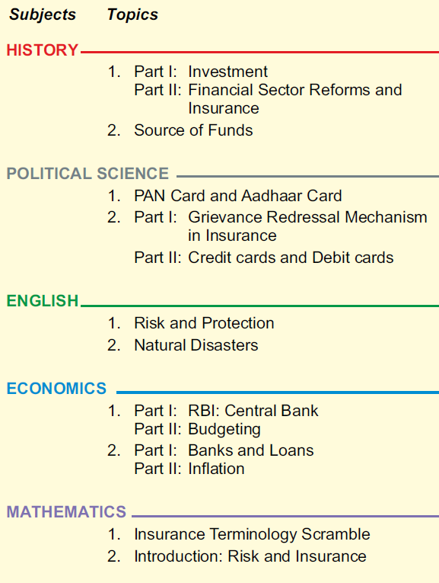
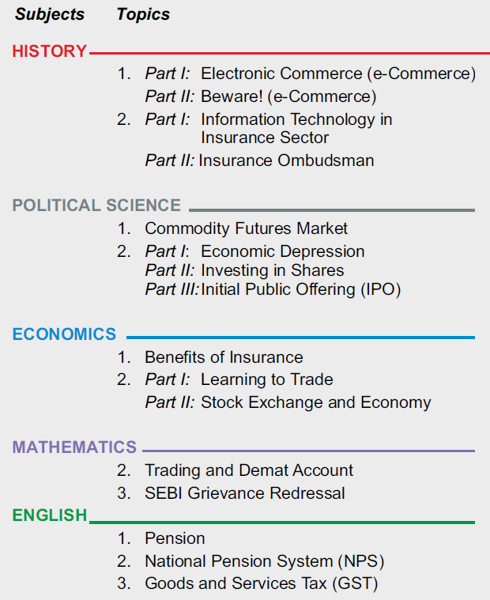
Class IX - Workbook
Class X - Workbook

Slide 130
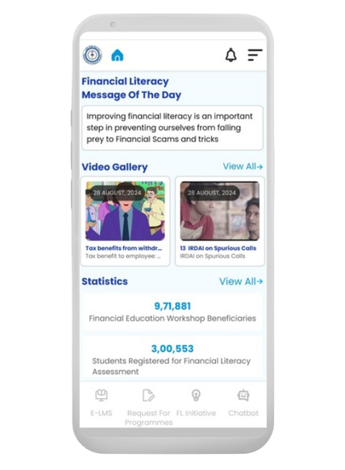

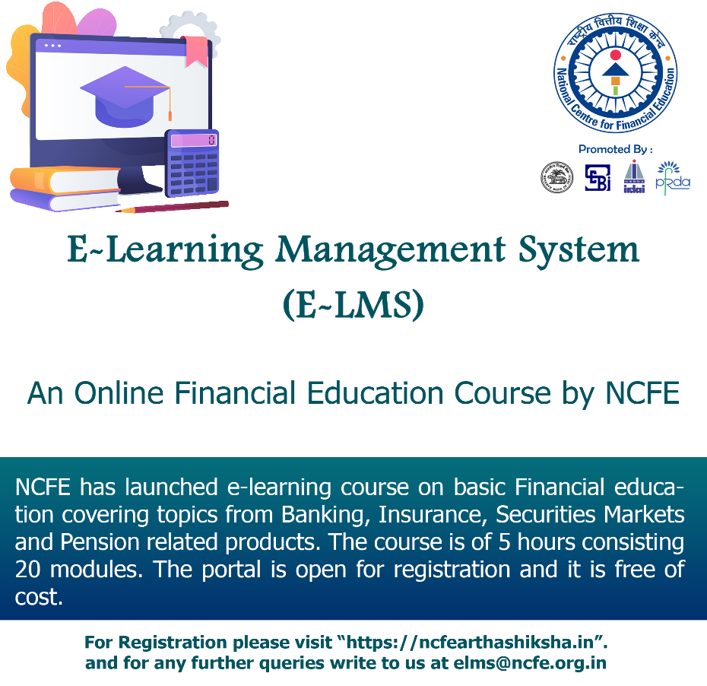

E – LMS & Financial Literacy Mobile App of NCFE
Free E-Certificate after complementing the course.
Anywhere anytime learning at own space.
Mobile friendly, E-LMS course is available in FL Mobile App
Use of audio visual for easy understanding.
Link for sample video: https://ncfe.org.in/program/e-lms

Slide 131

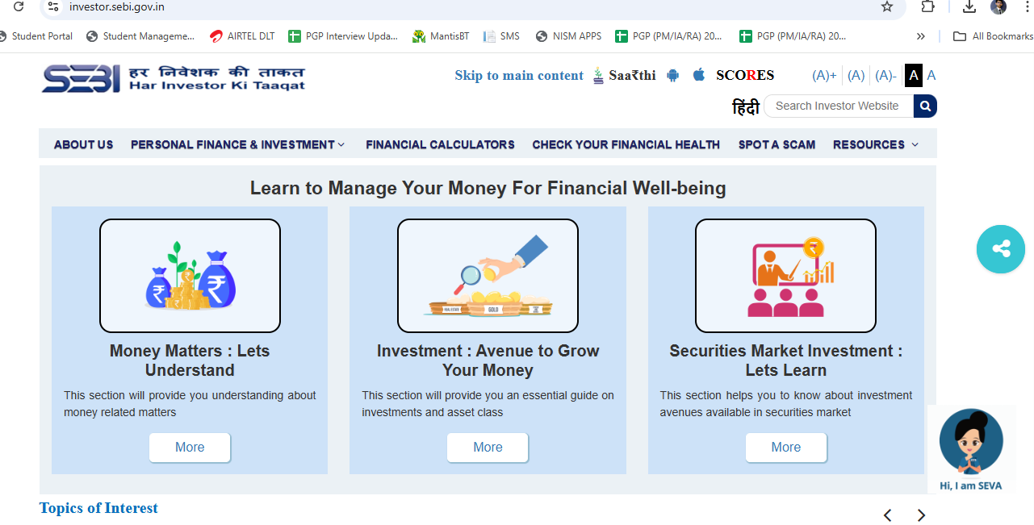
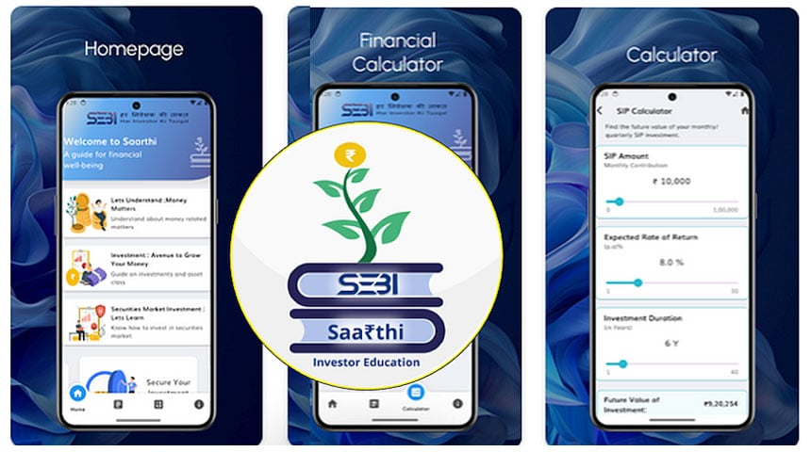


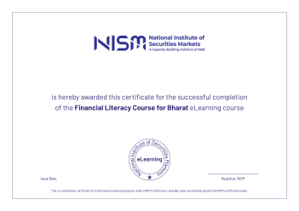
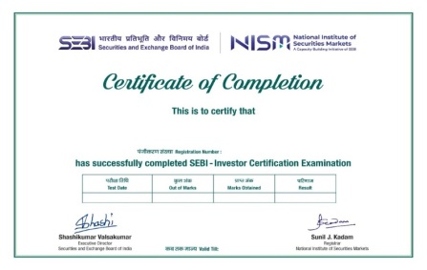
Initiatives of SEBI & NISM
For more details visit: https://investor.sebi.gov.in/
The app can be downloaded on: https://play.google.com/store/apps/details?id=com.sebi.invapp
For more details, visit: Click Here (https://www.nism.ac.in/nism-certifications-2/sebi-investor-certification-examination/)
For more details, visit: Click Here (https://online.nism.ac.in//module/Financial%20Literacy%20Course%20for%20Bharat.html)

Slide 132




Thanks!
Any questions ?
You can reach us at
National Centre for Financial Education, NISM Bhavan, Plot No 82, Sector 17, Vashi, Navi Mumbai 400703
facebook.com/ncfeindia
twitter.com/ncfeindia
info@ncfe.org.in
022 6826 5-115

