Slide 1
FINANCIAL AWARENESS AND CONSUMER TRAINING (FACT)

Slide 2
ABOUT US
NCFE is promoted by the financial sector regulators i.e. RBI, SEBI, IRDAI and PFRDA, set up under guidance of the Technical Group on Financial Inclusion and Financial Literacy of the Financial Stability and Development Council (FSDC) to implement the National Strategy for Financial Education (NSFE).

Slide 3
VISION & MISSION
VISION: A financially aware and empowered India.
MISSION: To undertake massive Financial Education campaign to help people manage money more effectively to achieve financial well being by accessing appropriate financial products and services through regulated entities with fair and transparent machinery for consumer protection and grievance redressal.

Slide 4
WE BELIVE…

Slide 5
FINANCIAL LITERACY LEADS TO FINANCIAL INCLUSION
WHICH ENABLES PEOPLE TO ACHIEVE...
FINANCIAL

Slide 6
WHAT IS
FINANCIAL LITERACY

Slide 7
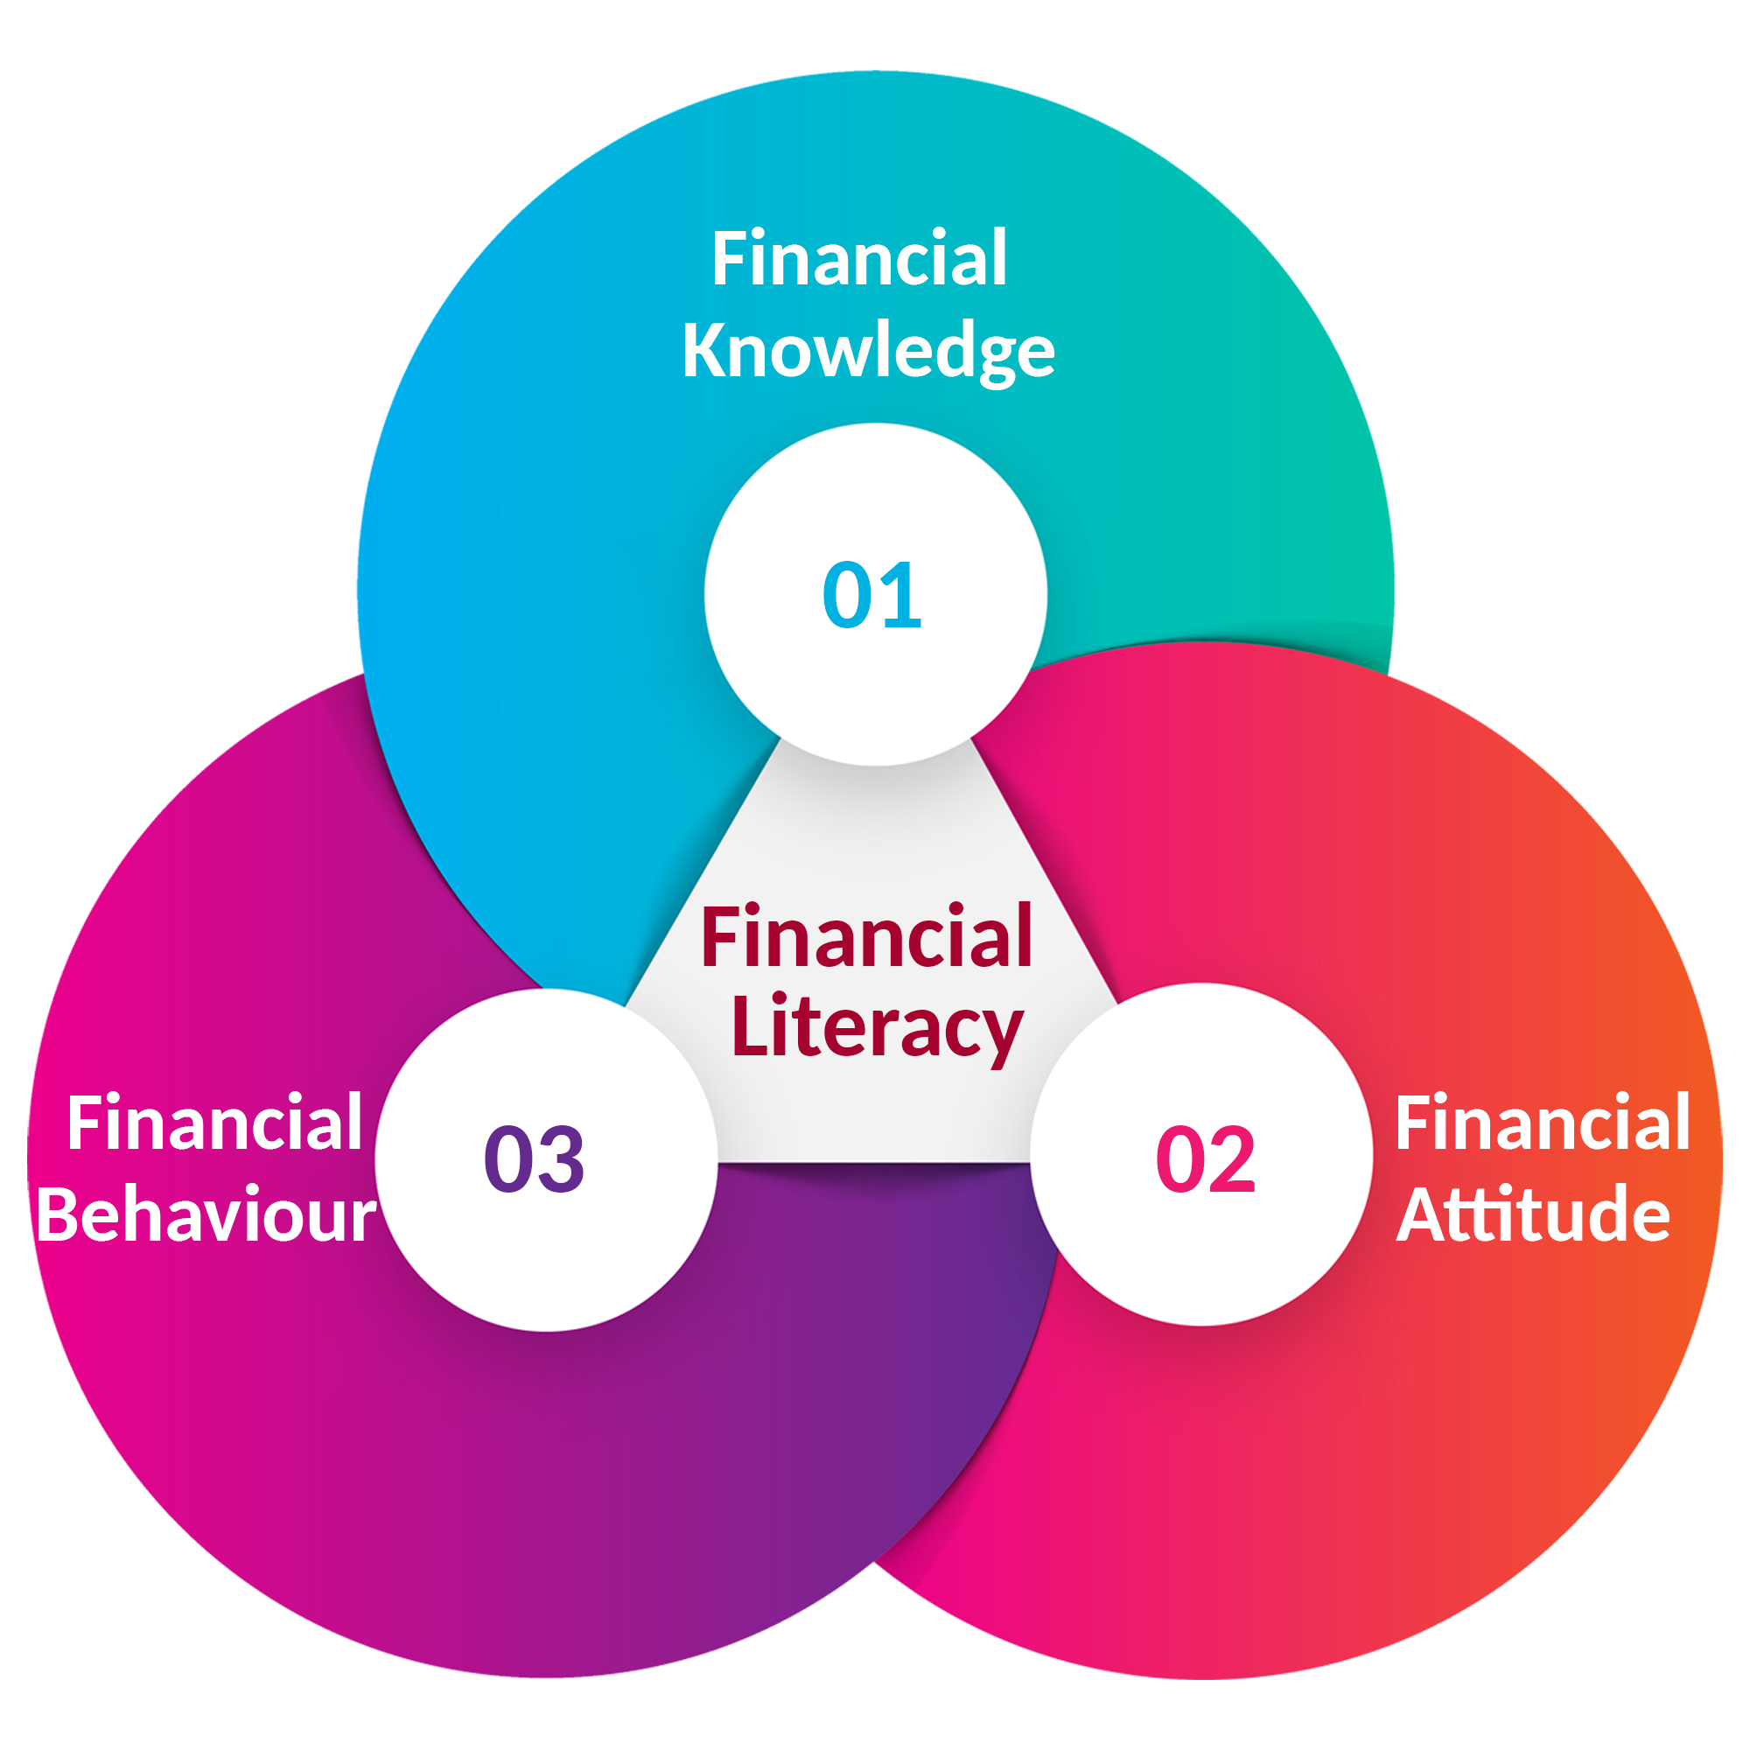
FINANCIAL LITERACY
Financial Literacy It is a combination of Financial Knowledge, Financial Behaviour, and Financial Attitude necessary to make sound financial decisions and ultimately achieve individual financial wellbeing.

Slide 8
LET'S START
Identity theft protection
Use your credit card responsibly
Student loan borrowing principles
Avoid impulse buying
Let's go cashless
Your first pay Cheque

Slide 9
Identity theft
PROTECTION
1

Slide 10
1/5
People use
password
as their password.

Slide 11
MISCONCEPTION
We think Identity theft only happens to people with money, but the truth is you don't have to have money to be a victim.

Slide 12
Identity theft is real.
Get serious Not scared!
Any kind of deception, scam, or crime that results in the loss of personal data, including the loss of user names, passwords, banking information, credit and PAN card numbers, etc., that is then used without your permission to commit fraud and other crimes.

Slide 13
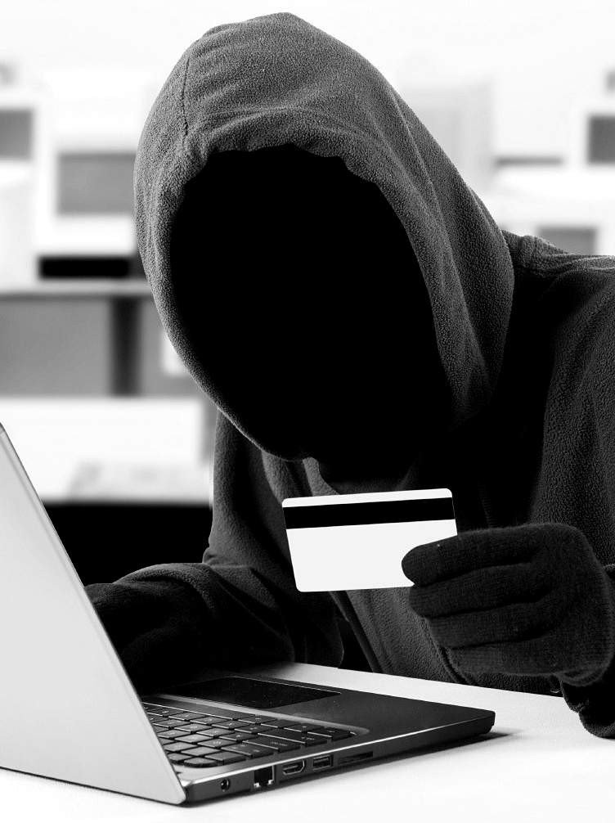
How it occurs?
Phishing emails, lottery and job scams Download malware onto computers or smartphones that steals information
Connect to wireless networks that are insecure Take out money from an ATM that has been rigged with a skimming device
Share passwords with untrustworthy people Information stolen from e-commerce and other sites you frequently visit, etc.

Slide 14
PROTECT YOURSELF
1
Keep a list of all of your credit, ATM/debit cards and emergency phone numbers of each issuer in a secure place quickly accessible by you.
2
3
Don’t throw the receipt after withdrawing money from an ATM. It has the last 4 digits of your card number.
Don't let your credit card out of your sight when you use it to pay in a store or restaurant.
O
4
Check your bank statements and credit score regularly.
5
6
Avoid posting your date of birth, mother's maiden name or other personal information on social networking websites.
Don’t give your PAN card number, ATM/debit or credit card number & PIN to anyone who call you.
R E
7
Always opt for email or SMS alerts offered by your bank that tells you about any activity in your account.
W
8
9
Set strong passwords with upper- and lower- case letters, numerals, and special characters.
Protect your computer and smartphone. Regularly update anti- virus, anti-spyware, and anti-phishing software.

Slide 15
If you suspect you've been a victim of identity theft, act quickly. Contact your creditors and financial institutions to report unauthorized charges or debits, and freeze any compromised accounts.
File a report with your local police.

Slide 16
2
Use your
CREDIT CARD
RESPONSIBLY

Slide 17
If you don’t know how to use credit cards responsibly, it can be dangerous.
CREDIT CARDS ARE A PARADOX.
But if you’re smart about credit cards, they can help you improve:
your credit score earn reward points
manage your short-term borrowings, etc. Avoid the need of carrying cash

Slide 18
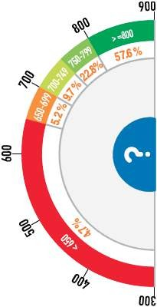
YOUR LOAN APPROVAL DEPENDS ON YOUR CREDIT SCORE.
Credit score shows the creditworthiness of a person and is the determining factor for the approval of a loan or credit card application.
Figures on the right shows the relationship between CIBIL score and percentage of new loans approved.

Slide 19
ANNUAL FEES
KNOW YOUR CREDIT CARD
INTEREST CHARGES
You're offered a "FREE" card
Fee waived off for lifetime or the first year?
Joining and annual maintenance fees
After first year, fees can be a minimum of Rs. 200 and higher
If outstanding bill is not paid within due date
Monthly interest rate of 2 to 4 percent only
What is hidden is this rate is annualized (24-48%) Understand APR (Annualized Percentage Rate)

Slide 20
MINIMUM PAYMENT TRAP
LATE PAYMENT CHARGES
Hefty penalty charges for not paying within due date
Fee can be either fixed or depend upon the outstanding amount
Fee amount can be Rs. 500 or higher Late payment will affect credit score
Lured to pay only the minimum due amount
Generally, 2 to 5 percent of total outstanding amount
On a bill of Rs. 25,000 and an APR of 36%, if you only make the minimum payments, it would take around 20 years and Rs. 62,000 to payoff the total debt.
CASH WITHDRAWAL
Withdrawing cash from ATM has both interest charges and a fee Interest is charged from day 1
Fee is typically Rs. 300 fixed or 2.5 percent whichever is higher

Slide 21
CASH WITHDRAWAL
CROSSING THE LIMIT
FOREIGN TRANSACTIONS
Exceeding the credit limit has charges
Even if you exceed by just 1 rupee Fee is typically Rs. 500 fixed or 2.5 percent whichever is higher
Buying something in Dollar or Euro would cost you extra
Transaction is converted to INR Transaction charge is typically 3.5 percent

Slide 22
Regularly check your account activity online. Be aware of the marketing gimmicks. Feel secure with access to an emergency line of credit.
HOW TO USE YOUR CREDIT CARD RESPONSIBLY?
1
2
3
The 30% credit utilization rule. Not using a credit card can be as bad as overusing.
Pay off your balance in full before due date.
Track your discretionary spending. Get fraud and purchase protection.

Slide 23
3
Education Loan
BORROWING PRINCIPLES

Slide 24
EDUCATION IS MORE VALUABLE THAN MONEY, IN THE LONG RUN.
Robert Kiyosaki
Author of Rich Dad Poor Dad

Slide 25
EDUCATION LOAN PRINCIPLES
Have a clearly defined academic and career goal.
Start early. Have a repayment strategy even before you finish your education
Take advantage of interest rate fluctuations.
Set a comfortable EMI. Don’t be over ambitious.
1
3
5
7
2
4
6
8
Contribute all that you can before considering loan options.
Make use of the moratorium period. Save and build a corpus.
Student borrowers get many relaxations like women can seek a lower rate.
Loan repayment is not your only priority. Save and invest for future goals.
Notes:
Foto oleh Luis Quintero dari Pexels

Slide 26
SHOULD YOU PREPAY?

Slide 27
Do your own
cost-benefit analysis
Potential costs
Interest payment on loan. Banks may have prepayment penalty charges.
Potential fluctuations in future interest rates.

Slide 28
Do your own
cost-benefit analysis
Potential benefits
Interest paid is eligible for tax deduction u/s 80E.
Potential earning from investments.
Potential fluctuations in future interest rates.

Slide 29
WHAT IF YOU DON'T GET A JOB?
For exceptional and genuine cases banks may consider extending the repayment period.
Talk to your bank.

Slide 30
4
Avoid
IMPULSE BUYING

Slide 31
IMPULSE BUYING
We have all done it! Take a moment to look around your house and you’ll probably find lots of products that you never really use.

Slide 32
WHY WE BUY IMPULSIVELY
Shopping is fun
Buying is an act of empowerment and we derive pleasure from it.

Slide 33
WHY WE BUY IMPULSIVELY
Loss aversion
Because we don't want to miss out on the limited period offer.

Slide 34
WHY WE BUY IMPULSIVELY
Desire to save
Its very difficult to resist the idea that we will save if we buy now.

Slide 35
WHY WE BUY IMPULSIVELY
Better than average
We believe we are better than average in looks, in driving, in parenting, etc.

Slide 36
IMPULSE BUYING INEVITABLY LEADS TO BUYER’S REMORSE, PARADOXICALLY BRINGING UNHAPPINESS.

Slide 37
HOW TO
AVOID IMPULSE BUYING
Plan your purchases
Important to make a list before you go shopping
Stick to your list
Save for your purchases and shop around to find a better price
Make a 30-day rule. When you feel the urge to buy something, wait for 30 days.

Slide 38
HOW TO
AVOID IMPULSE BUYING
No window shopping
Don't go to the mall unless a specific purpose
Avoid window shopping for entertainment Find alternate ways for free fun activities like visit museum or art gallery, park, movie at home, etc.

Slide 39
HOW TO
AVOID IMPULSE BUYING
Lean on friends
Phone a friend to take your mind off shopping
Picnic at the local park or play some board game

Slide 40
HOW TO
AVOID IMPULSE BUYING
Calculate value in hourly wage
Calculate what's your hourly wage
Divide the price of the item by your hourly wage
Is it worth giving up that many hours for the item?

Slide 41
BEFORE YOU BUY, ASK QUESTIONS?
URGENT IMPORTANT
BUY NOW
NOT URGENT IMPORTANT
PLAN TO BUY LATER
URGENT NOT IMPORTANT
BUY IF YOU CAN AFFORD
NOT URGENT NOT IMPORTANT
DO NOT BUY

Slide 42
5
Let's go
CASHLESS

Slide 43
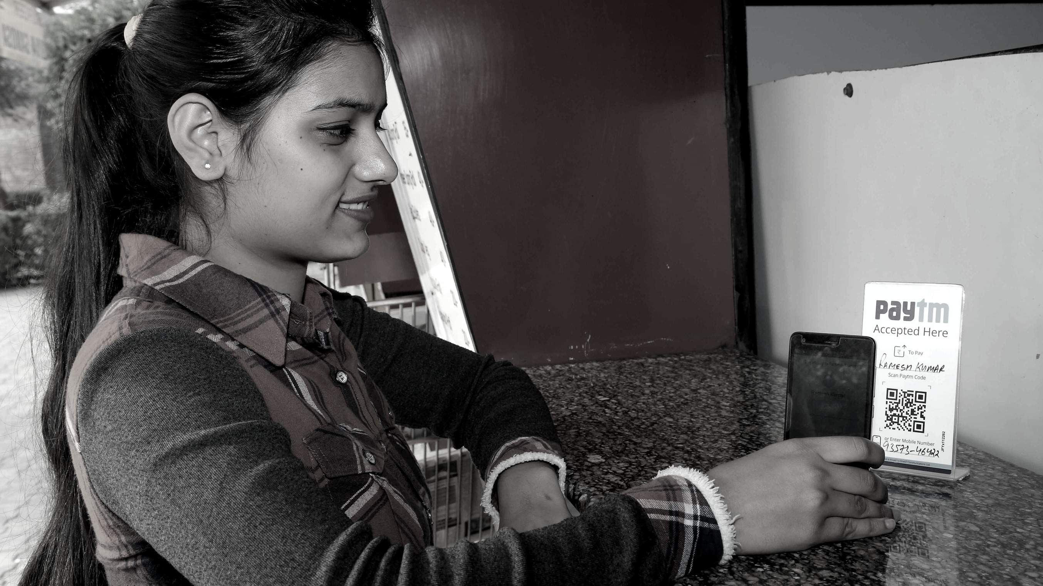
TRANSACTIONS WITHOUT CASH
IT'S POSSIBLE

Slide 44
1. Internet Banking
DIGITAL PAYMENT METHODS
Mobile Banking
Debit and Credit Cards
Mobile Wallets
Aadhaar Enabled Payment System (AEPS)
Unified Payment Interface (UPI)
Unstructured Supplementary Service Data (USSD)
Bharat Interface for Money (BHIM)

Slide 45
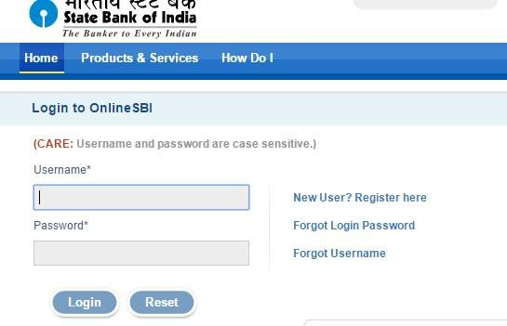
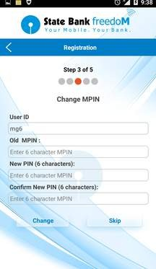
INTERNET BANKING
MOBILE BANKING
NEFT (National Electronic Fund Transfer) RTGS (Real Time Gross Settlement)
ECS (Electronic Clearing System) IMPS (Immediate Payment Service)
Use of mobile apps for banking transaction

Slide 46
DEBIT AND CREDIT CARDS
Visit nearest bank branch Provide KYC
Apply for Debit/Credit Card Get a PIN
Visit an ATM to activate PIN
Use at ATMs, shop online, pay at shops

Slide 47
MOBILE WALLETS
Electronic pre-paid payment system
Need a bank account and smart phone with internet
Download and install the app
Load money using net banking or credit/debit card
Consumer wallet limit - 2 lakh (those who completed full KYC)
Use for making payments Add, receive and send money

Slide 48
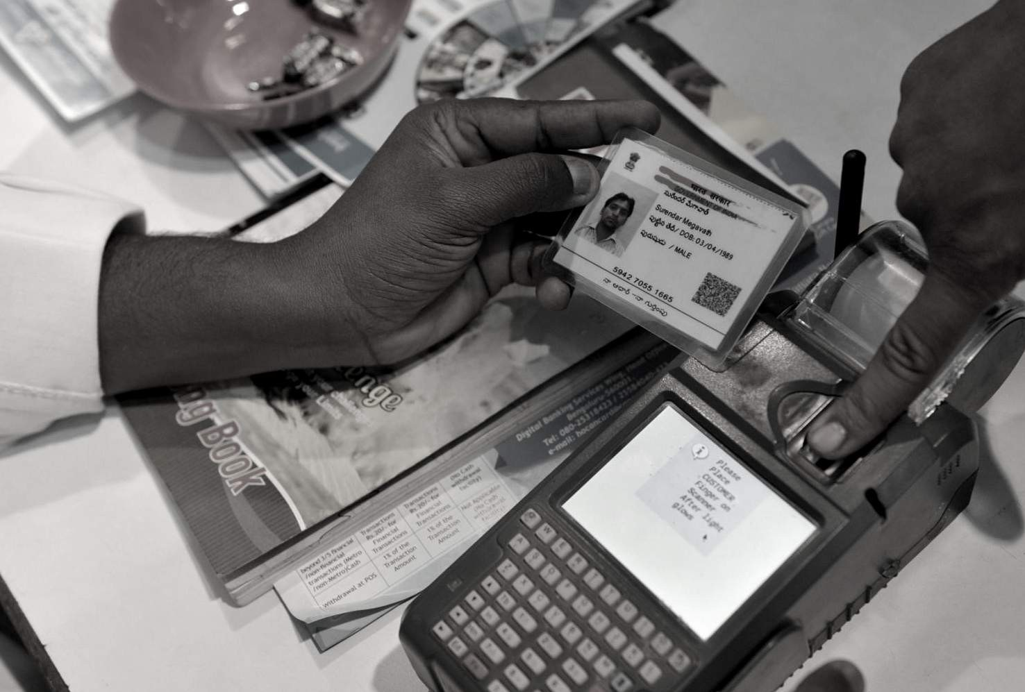
AADHAAR PAY
Aadhaar should be linked with bank account
Transaction through Bank Mitra at POS (Micro ATMs)
Transaction without pin or password Aadhaar to Aadhaar fund transfer, balance inquiry, cash deposit and withdrawal
Payment at shops
Transaction cost zero for consumers

Slide 49
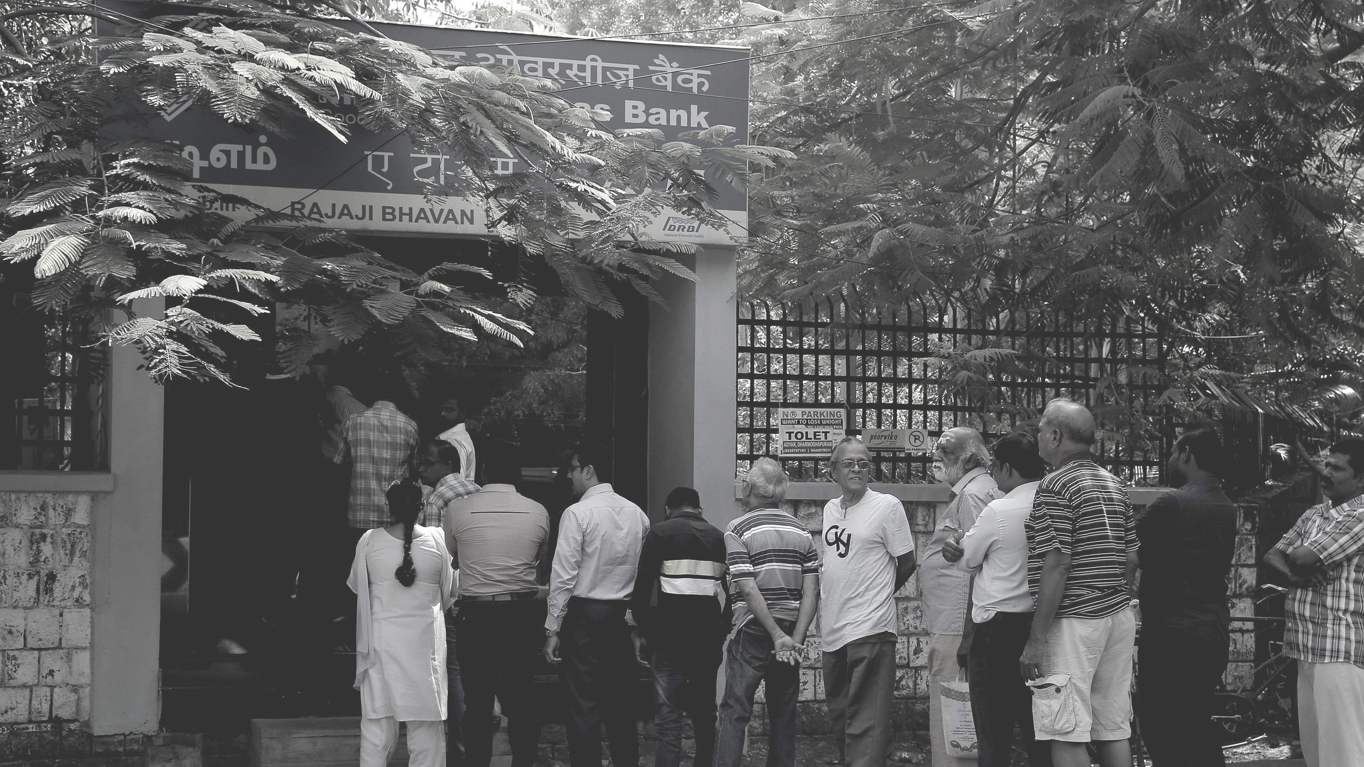
NO MORE STANDING IN QUEUE;
UNIFIED PAYMENTS INTERFACE (UPI)
|

Slide 50
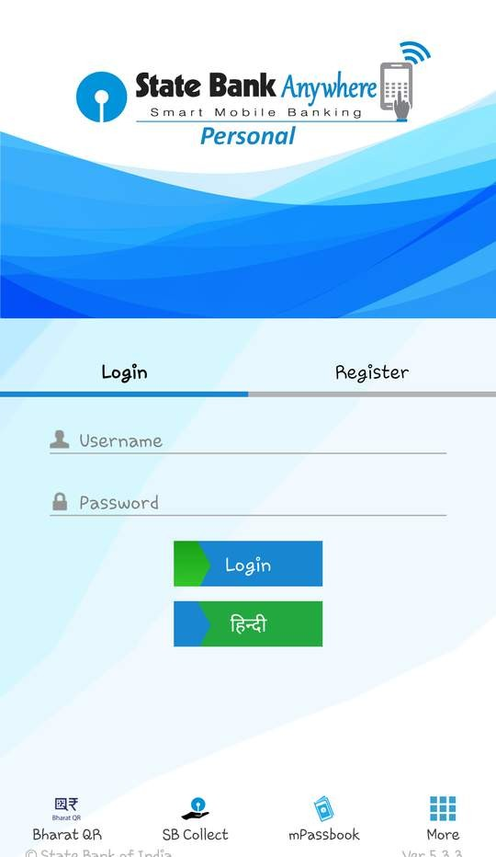
WHAT IS UPI?
You need a smartphone with internet facility
Mobile number must be linked with bank account
Allows various types of financial transactions
Send or receive money using VPA
No need to remember banking information
Interoperable

Slide 51
UPI REGISTRATION PROCESS
DOWNLOAD ANY BANK'S APP OR ANY 3RD PARTY APP
CHOOSE YOUR UNIQUE ID (AADHAAR OR MOBILE NUMBER) AS VPA
SELECT YOUR BANK
REGISTRATION COMPLETE
SET YOUR M-PIN FOR VALIDATING TRANSACTIONS
GIVE YOUR BANK ACCOUNT DETAILS FOR THE FIRST TIME

Slide 52
HOW TO SEND MONEY THROUGH UPI?
SELECT 'SEND MONEY'
ENTER PAYEE'S VPA
ENTER THE AMOUNT
WRITE TRANSACTION REMARKS
CONFIRM DETAILS
Why need cash when you can have the bank in your mobile?
CLICK SEND

Slide 53
*99#
UNSTRUCTURED SUPPLEMENTARY
SERVICE DATA (USSD)
WHO NEEDS A SMARTPHONE WHEN YOU'RE
SMART?

Slide 54
*99#
NATIONAL UNIFIED USSD PLATFORM (NUUP)
Banking transactions using basic feature phone Mobile number should be linked with bank account Register for USSD and generate MMID and MPIN Payments upto Rs. 5000 per day
Common across all telecom service providers Per transaction charge 50 paisa

Slide 55
HOW TO
TRANSFER MONEY USING USSD
Dial *99# from your registered mobile phone
Type first 3 letters of your bank's short name or first 4 letters fo your bank's IFSC
Enter your option
Account balance
Mini statement
Send money-MMID
Send money-IFSC
Send money-AAdhaar
Show MMID
Change MPIN
Generate OTP
Enter beneficiary's 10 digits mobile number
*99#
SBI or SBIN
3
7979797979

Slide 56
HOW TO
TRANSFER MONEY USING USSD
Enter beneficiary's 7 digits MMID
Enter amount and remarks (optional) with a single space
Enter your MPIN and last 4 digits of your account number with a single space
Transaction complete
4545454
500 Rent
1234 5678

Slide 57
BHIM IS AN APP THAT LETS YOU MAKE EASY AND QUICK PAYMENT TRANSACTIONS USING UPI.

Slide 58
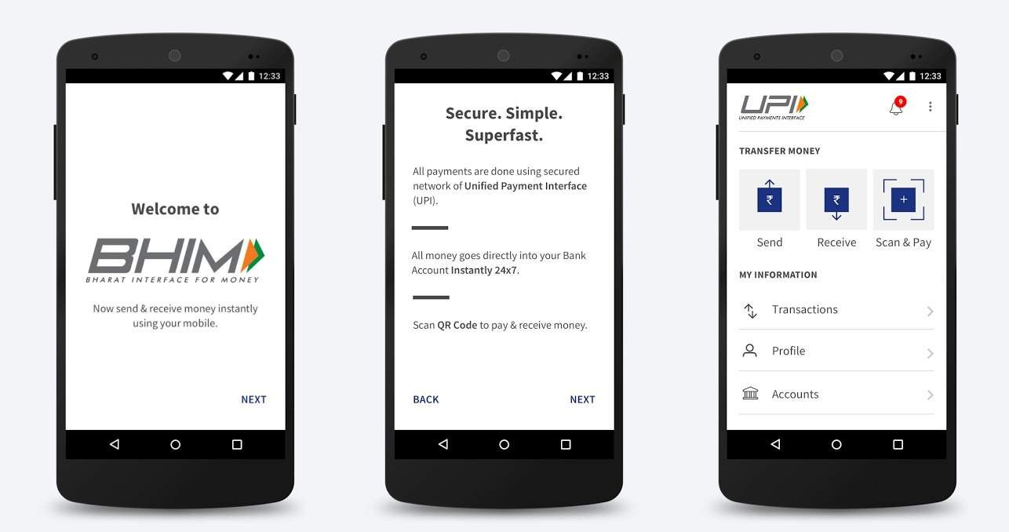
GO CASHLESS
SIMPLE, SECURE AND FAST TRANSFERS
SEND, RECEIVE AND REQUEST MONEY

Slide 59
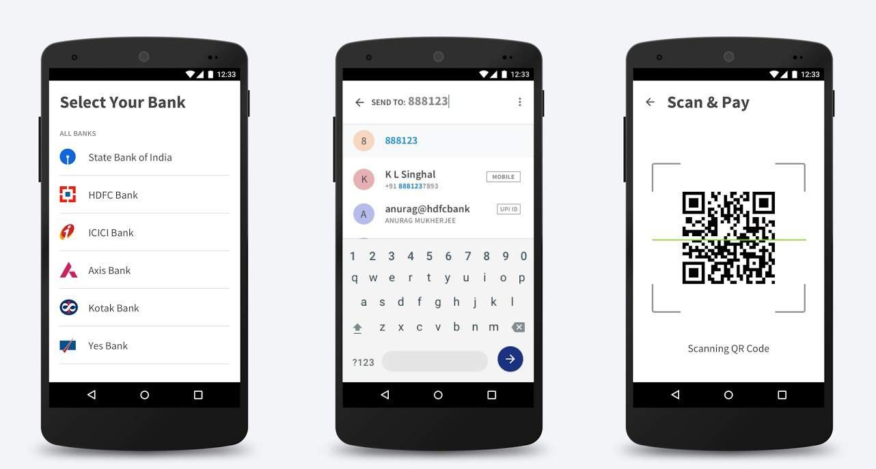
ONE APP FOR ALL BANKS
SEND/RECEIVE TO MOBILE AND VPA
SCAN QR CODE TO PAY INSTANTLY

Slide 60
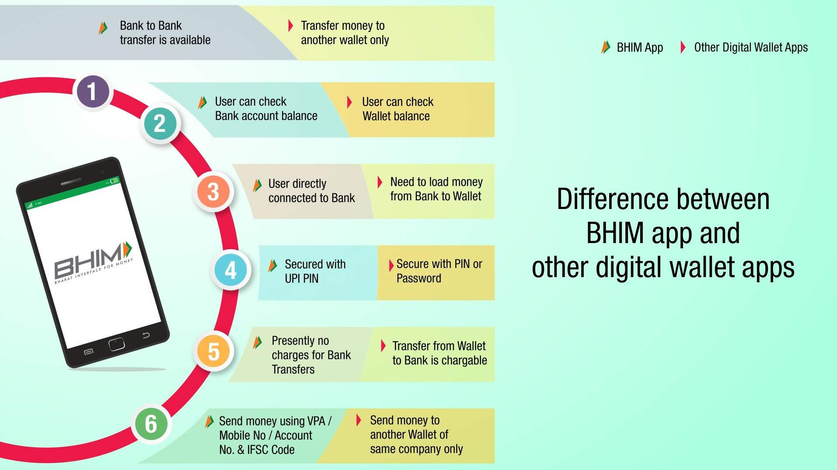
|

Slide 61
HOW TO
USE BHIM APP?
Download and Install BHIM app from Google Play store/Apple App Store
Allow app to manage SMS and phone calls
Select your preferred language

Slide 62
HOW TO
USE BHIM APP?
Select SIM card which has the mobile number registered with your respective bank.
Set the application passcode required to enter the app
Select your bank from the list

Slide 63
HOW TO
USE BHIM APP?
Set your UPI PIN by providing last 6 digits of debit card and expiry date of debit card
Create your VPA and QR Code. mobilenumber@upi will be your default VPA
Start transacting (Send, Receive, Scan/Pay)

Slide 64
6
Your first
PAY CHEQUE

Slide 65
LET'S TALK ABOUT HOW YOU MANAGE YOUR MONEY
CONGRATULATIONS!!

Slide 66
WHETHER YOU WILL REACH YOUR LIFE GOALS?
will be determined by
How much you earn?
How you spend?
How you save?
Where you invest?

Slide 67
LIFE G ALS
Paying off your student loan Starting your own business Buying a car, your dream house Going on a vacation
Your marriage, starting a family Retirement, etc.

Slide 68
Open an emergency savings bank account Emergencies are unpredictable
Should cover at least 3 to 6 months of your expenses
Set aside a small amount every month Only use in case of an emergency.
Start rebuilding the fund immediately, if used
Emergency Savings Account
Compulsory saving
EPF enables you to enjoy your retirement 12% of your salary and a matching contribution from employer
Contribution has tax benefits
You can also open a PPF account
Employees Provident Fund

Slide 69
EPF CASE STUDY
AGE | 25
MONTHLY BASIC SALARY | Rs. 10,000
YOUR CONTRIBUTION (%) | 12
EMPLOYER'S CONTRIBUTION (%) | 3.67
AVERAGE ANNUAL INCREMENT (%) | 5
RETIREMENT AGE | 60
AVERAGE EPF INTEREST RATE (%) | 8
Approx. 78.5 lakh

Slide 70
LIFE & HEALTH INSURANCE
insurance is a risk management tool
Don’t expect monetary returns and buy the wrong policy
Never neglect health insurance
Your age is a major factor in calculation of premium. Buy early.
Carefully consider all options before buying. Buying these insurance has tax benefits

Slide 71
HOW MUCH
INSURANCE SHOULD YOU BUY?
One size fits all - does not apply
Life cover - At least 10 time your annual gross salary
Health cover - 50% of your annual income plus last 3 years expense on health Important to increase cover amount based on your income, health condition and medical inflation

Slide 72
KEY POINTS
Insurance is not investment Buy term life insurance Consider claim payout ratio before buying
Buying online can save you some premium amount
Centre for Financial Education | 96

Slide 73
AROUND 2% RETIREES ARE TRULY FINANCIALLY FREE
WHERE DO YOU WANT TO BE?

Slide 74
NATIONAL PENSION SYSTEM

Slide 75
Eligible for all Indians (including NRIs) Age group 18 to 60
Portable unique PRAN
Tax benefit u/s 80CCD upto 2 lakhs Flexible investment options include equity, corporate and government bonds

Slide 76
NPS ACCOUNT DETAILS
TIER I ACCOUNT
TIER II ACCOUNT
Members of Tier I
NIL
Rs. 250/-
Any time
No
PARTICULARS
Eligibility
All Indians ( age 18 to 70)
Min annual contribution
Rs. 1000/-
Rs. 500/-
Min amount per contribution
Conditional
Liquidity
Up to 2 lakhs u/s 80CCD
Tax benefit

Slide 77
Before 60 years
After 60 years
Less than 5 lakh 100% withdrawn
More than 5 lakh,Can withdraw upto 60%; rest 40% to be used for buying an annuity for monthly pension.
In case of death
Nominee can withdraw all the money at one go or can continue with the scheme.
Less than 2.5 lakh 100% withdrawn
More than 2.5, Only 20% can be withdrawn; rest 80% to be used for buying an annuity for monthly pension.
WITHDRAWAL/EXIT FROM NPS

Slide 79
CASE STUDY
Age (in years) |  | 25
Retirement age (in years) |  | 60
Monthly investment in NPS (in Rupees) |  | 5,000
Return (last 5 years avg % return in scheme C) |  | 11%
Total corpus amount (in Rupees) |  | 2,48,67,363
Amount for purchase of annuity at 40% (in Rupees) |  | 99,46,946
Withdrawal on maturity at 60% (in Rupees) |  | 1,49,20,417
Assumed annuity rate (in percentage) |  | 8%
Monthly pension amount (in Rupees) |  | 66,313

Slide 80
INVESTMENT IN MUTUAL FUNDS
Equity Linked Savings Scheme (ELSS)

Slide 81
Stocks
MUTUAL FUND
is a convenient way
through which we can invest in most type of assets.
Bonds
Gold
Real Estate

Slide 82
BENEFITS
Professional expertise: Investing requires knowledge and skills Convenient: With bank a/c and pan card you are ready to invest Diversification: Manages risk by investing in different companies/assets Low cost: Advantage of economies of scale
Transparent: Regulated by Securities and Exchange Board of India
Liquidity: Getting in and out with relative ease
Affordable: Minimum investment requirement is as low as Rs. 500/- Long term growth: Potential for higher return that beats inflation
Tax benefit: ELSS are tax saving mutual funds

Slide 83
ELSS
Even out market volatility through SIP
Minimum 65% allocation to equity
Tax saving upto
1.5 lakh u/s 80C
Min investment Rs. 500 and 3 yrs lock-in
Long term wealth creation

Slide 84
While you have much to look forward to, your transition to post-college life...
...there is one key to reaching all your financial and most of your life goals.
BUDGET

Slide 85
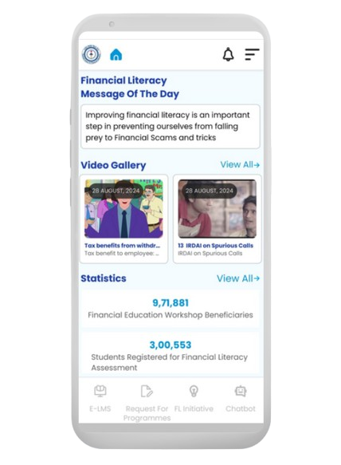
E – LMS & Financial Literacy Mobile App of NCFE
Free E-Certificate after complementing the course.
Anywhere anytime learning at own space.
Mobile friendly, E-LMS course is available in FL Mobile App
Use of audio visual for easy understanding.
Link for sample video: https://ncfe.org.in/program/e-lms

Slide 86
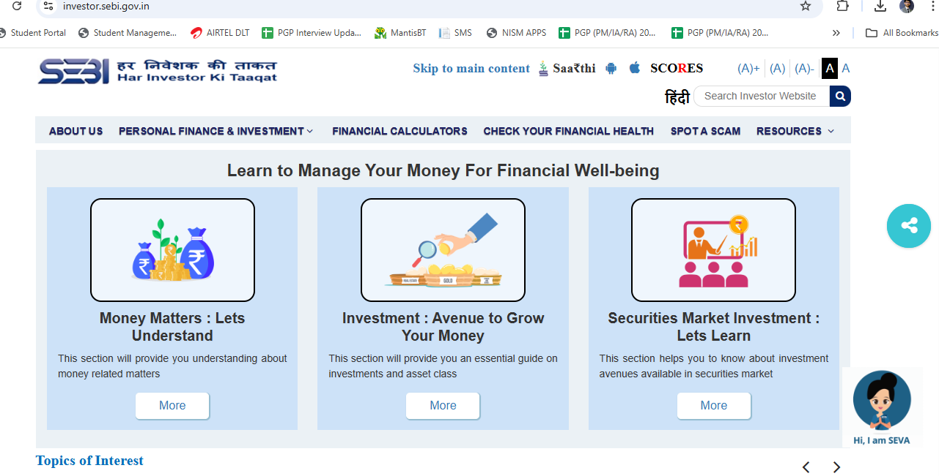
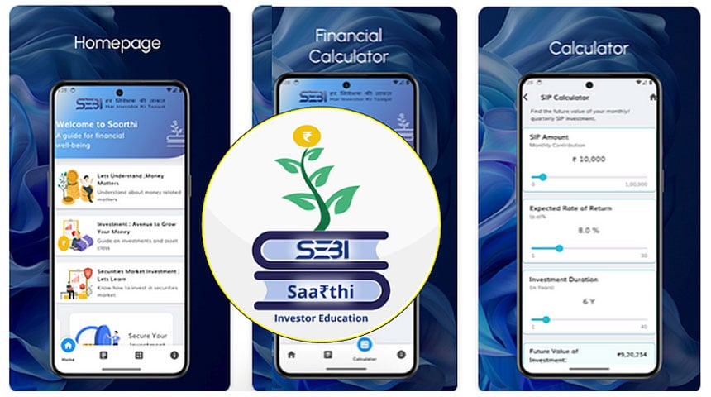
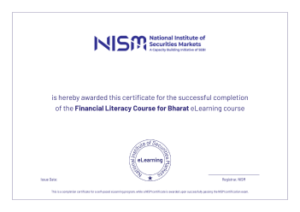
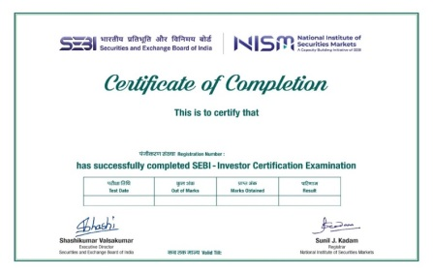
Initiatives of SEBI & NISM
For more details visit: https://investor.sebi.gov.in/
The app can be downloaded on: https://play.google.com/store/apps/details?id=com.sebi.invapp
For more details, visit: Click Here (https://www.nism.ac.in/nism-certifications-2/sebi-investor-certification-examination/)
For more details, visit: Click Here (https://online.nism.ac.in//module/Financial%20Literacy%20Course%20for%20Bharat.html)

Slide 87
Connect with us:
Facebook.com/ncfeindia | Twitter.com/ncfeindia
Thank you.
let's create a financially aware and empowered india.

