Slide 1
FINANCIAL EDUCATION PROGRAMME FOR ADULTS (FEPA)

Slide 2
About NCFE
NCFE is a Section 8 (Not for Profit) Company promoted by RBI, SEBI, IRDAI and PFRDA under the aegis of the Technical Group on Financial Inclusion and Financial Literacy of the Financial Stability and Development Council (FSDC) to implement the National Strategy for Financial Education (NSFE).
MISSION
To undertake massive Financial Education campaign to help people manage money more effectively to achieve financial well being by accessing appropriate financial products and services through regulated entities with fair and transparent machinery for consumer protection and grievance redressal.
VISION
A financially aware and empowered India.

Slide 3
Basic concepts – Income, Expense, Budgeting and Saving
Are you sometimes short of cash at the end of the month? Don't seem to be able to save for the things you really want?? Learn to balance your income with your expenses
Need: A necessity, something that is required, something that is essential for life
Want: A desire, something that is wished for, something that is non-essential
Setting priorities: Needs and Wants
It is very important to know the difference between your needs and your wants. This will help you in setting your priorities so that you know where to spend your money.
“A roof over my head" is a Need. So are clothing, food and medications. "Watching movies in theatre" is a Want, and so are buying an expensive saree, jewellery, etc.

Slide 4
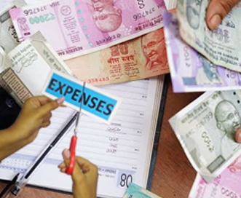
Income and Expenses
Keep every receipt
Record every expenses daily
Total your expense at the end of the month
Do this for three months
Income :
Active Income through job, business, farming, pension, etc.
Passive income through interest income from their investments, pension etc.. You need to know how to keep track of it and manage it to cover your expenses and save for future.
Expense : It costs money to live. You need to pay for food, clothing, housing, transportation, communication, and a dozen other necessary expenses. Then there are things like vacations, entertainment, gifts for relatives and so on.
Know what your expenses are
Reduce unnecessary spending

Slide 5
Budgeting
Set SMART financial Goals
It is simply a comparison of income and expenses.
If it is positive, you have a surplus. Congratulations! With the extra money you must pay off any debt or loan if you have. Otherwise you can increase your monthly savings amount or invest for future
If it is negative, you have a deficit. You need to increase your income to balance your budget. Reduce your expenses by focusing on what are your needs rather than wants.
The difference between your total income and expense :
SHORT TERM
MEDIUM TERM
LONG TERM
Plan for buying a TV
Paying for a wedding
Plan for Retirement

Slide 6
SAVING
Saving is a key step to make sure your future is financially secure. Start early to give your savings as much time as possible to grow !!
Why Save?
Help you to meet your goals and provide for your own future.
Without savings, when you want to purchase something, you have to borrow money.
Borrowing is expensive, because not only you have to pay it back, you also have to pay interest, often at a high monthly rate.
How to save?
Now that you've decided you want to save, how do you go about it?
For an example, “saving for a motorbike” is a vague and hard to measure. How will you know if you are making progress or have achieved it? On the other hand, “saving 50000 rupees for a 100 CC motorbike within 10 months” is SMART. Its specific – you know exactly what you are saving for. Its measurable – you know how much you will need. Its achievable and realistic – you can break the total amount needed into smaller steps (saving 5000 rupees a month) that will be easier to do. And its time bound you’ve set a deadline of 10 months
Notes:
This template was inserted from Power-user, the productivity add-in for PowerPoint, Excel and Word.
Install Power-user to access thousands of templates, icons, maps, diagrams and charts with Power-user.
Visit https://www.powerusersoftwares.com/
©Power-user SAS, terms of license: https://www.powerusersoftwares.com/terms

Slide 7
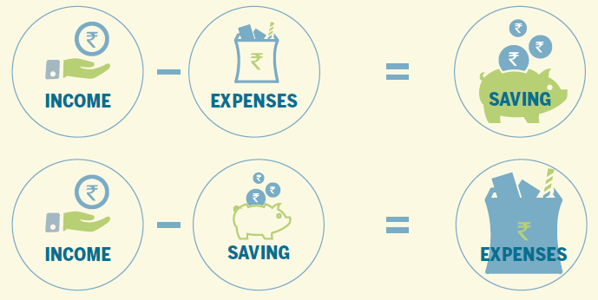
Which equation to be followed??

Slide 8
Financial Planning
Goal Identification
Goal Prioritization
Goal Amount Estimation
Goal Time Frame Estimation
Steps in Financial Planning

Slide 9
Inflation & Its impact on savings
* Inflation @ 6% p.a.
What we see on our passbook is called nominal rate of interest. An investor must look at real rate of interest (nominal-inflation).

Slide 10
BANKING
A bank is a financial institution that accepts deposits from public and creates credits. In India the Banking Sector is regulated by The Reserve Bank of India (RBI).
Credit/Loans
Secure Money
Earn Interest
Remittance using cheque, Demand Draft and other channels
Avoid Risk of Chit Funds, Sahukars
Inculcate Habit of Saving
Notes:
This template was inserted from Power-user, the productivity add-in for PowerPoint, Excel and Word.
Install Power-user to access thousands of templates, icons, maps, diagrams and charts with Power-user.
Visit https://www.powerusersoftwares.com/
©Power-user SAS, terms of license: https://www.powerusersoftwares.com/terms

Slide 11
Saving Related Products
Fixed Deposit
Savings
Account
Recurring
Deposit
Current Account
Savings related products
PPF
Account

Slide 12
Borrowing related products
Loans
Borrowing related products
Overdraft
Cash Credit
Credit Card

Slide 13
Banking in India
Public Sector Banks: Government hold majority stakes
Ex : SBI, PNB, BOB etc.
Private Sector Banks: Private shareholders hold majority stakes
Ex : HDFC Bank, ICICI, AXIS etc
Regional Rural Banks: To support the weaker section of the society like marginal farmers, laborers, small enterprises, etc.
Co-operative Banks: Mainly serve entrepreneurs, industries, small businesses
Payment Banks: Can accept deposits upto 1 Lakh, can not issue loans and credit cards
Small Finance Banks: Can accept deposits and basic lending. Target - small business units, small and marginal farmers, MSMEs and unorganized sector entities.​

Slide 14
Development Finance Institutions (DFI): Provides risk capital for economic development projects on noncommercial basis. Ex: NABARD, SIDBI, NHB etc.
Micro Finance Institution (MFI) : Offer micro credit and also facilitate provision of other financial services like insurance, remittance and non-financial services like individual counselling, training and support to start micro-businesses.
Non-Banking Financial Company (NBFC): Engaged in the business of loans and advances, acquisition of securities, leasing business, hire-purchase, insurance business, chit business etc.
They cannot become part of payment and settlement system
Business Correspondent (BC): Mode of providing banking service at our doorstep as bank branch is far off from our area.

Slide 15
Pradhan Mantri Jan-Dhan Yojana (PMJDY)
Universal access to banking services
Pension Scheme for unorganized sector
Creation of credit Guarantee Fund.
Basic Savings Bank Accounts with Overdraft facility of Rs. 10,000/- to every households
Financial Literacy Programme
Micro-Insurance
For more information visit : https://pmjdy.gov.in/
Notes:
This template was inserted from Power-user, the productivity add-in for PowerPoint, Excel and Word.
Install Power-user to access thousands of templates, icons, maps, diagrams and charts with Power-user.
Visit https://www.powerusersoftwares.com/
©Power-user SAS, terms of license: https://www.powerusersoftwares.com/terms

Slide 16
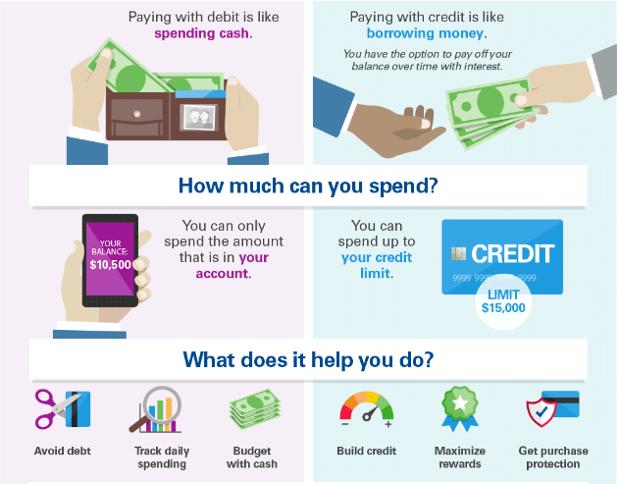
Credit and Debt Management
People need to borrow money for buying a house, car or children’s education. This is called credit.
Good vs Bad Debt
Good debt is an investment in something that creates value or produces more wealth in the long run. Bad debt is debt taken to buy something that immediately goes down in value.
Medium/Long term Credit
Ex: Housing loan, industrial loan
CREDIT
Medium/Long term Credit
Ex: Housing loan, industrial loan

Slide 17
Examples of Government Credit Schemes
Educational Loans through Vidyalakshmi Portal
Easy and effective system of getting educational loans so that no student leaves his/her education mid-way due to lack of funds
Common education loan application form is available for students. Visit: www.vidyalakshmi.co.in
Pradhan Mantri Awas Yojana (PMAY)
Credit Linked Subsidy Scheme for Lower Income Group/ Economically Weaker section and middle income group.
Individuals are eligible to avail subsidy when they are purchasing their first house or it is a new construction
Visit: https://pmaymis.gov.in
Pradhan Mantri Mudra Yojana (PMMY)
Government Scheme that offers business loans to proprietors or entrepreneurs of small & medium enterprises
Loans offered: SHISHU, KISHOR and TARUN depending up on the amount of loan availed
Key documents required: proof of identity, quotation of items purchased and category certificates
Visit: https://www.mudra.org.in

Slide 18
DIGITAL PAYMENTS
Digital payments are those payments in which the payer and the payee both use electronic modes to send and receive money.
Advantages of Digital Payments
Fast, Easy and Convenient.
Economical and less transaction fee.
Provides a digital record of transactions that customers can track.
Gives a one stop solution for any type of payments.
Helps in keeping a control on black money.
Do’s | Don’ts
Use password for your Mobile and Computer so that no one else can access your systems. | Never save your mobile banking login and password on the phone. Either memorize it or write it down somewhere else.
Always visit your bank’s secured internet Banking site regularly | Never Leave your handset unattended and logged into a mobile banking app.
Log out of your internet banking immediately after you have completed your transaction | Never leave your phone un-attended while carrying out financial transactions through mobile
If you suspect unauthorized transactions in your account, report it to your bank immediately | Never download apps from untrustworthy and dubious sources
Digital Payment Methods
Banking cards
Bank prepaid cards
Internet banking, mobile banking
Point of sale, Micro ATMs
Unstructured Supplementary Service Data (USSD)
Aadhaar Enabled Payment System (AEPS
Mobile wallets
Unified Payment Interface (UPI)

Slide 19
Internet Banking
Electronic payment system that enables customers of a bank or other financial institution to conduct a range of financial transactions through the financial institution's website.
National Electronic Fund Transfer (NEFT)
Transfer of funds from one Bank account to a different account of another Bank using Beneficiary’s account number and IFSC (Indian Financial System Code). (24 x 7)
Real Time Gross Settlement (RTGS)
Transfer of funds from one Bank account to a different account of another Bank on a real time basis facilitating high value transactions using Beneficiary’s account number and IFSC code. (24 x 7)
Immediate Payment Service (IMPS)
Transfer of funds from one Bank account to another facilitating instant Fund Transfer.
Minimum Limit: No limit Maximum Limit: No limit
Minimum Limit: 2 Lakh Maximum Limit: No limit
For fund transfer through Mobile, Mobile Money Identifier (MMID) issued by the bank is required. Transaction can also be done using Beneficiary’s account number and IFSC code.

Slide 20
Mobile Banking :Mobile banking is a service provided by a bank or other financial institution that allows its customers to conduct different types of financial transactions remotely using a mobile device such as a mobile phone or tablet.
Mobile Wallet: A mobile wallet is a way to carry cash in digital format. An individual's account is required to be linked to the digital wallet to load money in it. Most banks have their e-wallets and some private companies. e.g. Paytm, Freecharge, Mobikwik, Oxigen, Airtel Money, etc.
Point of Sale: A point of sale (PoS) is the place where sales are made. On a macro level, a PoS may be a mall, a market or a city. On a micro level, retailers consider a PoS to be the area where a customer completes a transaction, such as a checkout counter. It is also known as a point of purchase.
Micro ATMs :Micro ATM meant to be a device that is used by a million Business Correspondents (BC) to deliver basic banking services. The platform will enable Business Correspondents (who could be a local kirana shop owner and will act as ‘micro ATM’) to conduct instant transactions.
Unstructured supplementary service data (USSD): The innovative payment service *99# works on Unstructured Supplementary Service Data (USSD) channel. This service allows mobile banking transactions using basic feature mobile phone, there is no need to have mobile internet data facility for using USSD based mobile banking. It is envisioned to provide financial deepening and inclusion of underbanked society in the mainstream banking services.

Slide 21
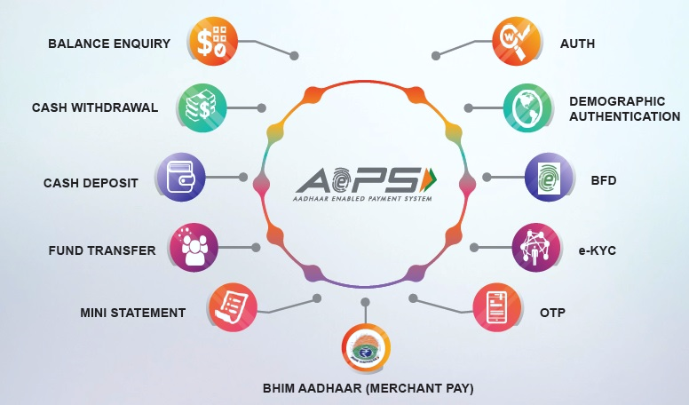
Aadhaar enabled payment system (AEPS)
AEPS is a bank led model which allows online interoperable financial transaction at PoS (Point of Sale / Micro ATM)
Unified Payments Interface (UPI)
A system that powers multiple bank accounts into a single mobile application (of any participating bank), merging several banking features, seamless fund routing & merchant payments into one place.
UPI Benefits To End User :
Privacy- Share only Virtual Payment Address and no other sensitive information
Multiple Utility – Cash on delivery/ bill split sharing/ merchant payments/ remittances
One click 2 FA – Authorise transaction by entering only the PIN
Work across various interfaces – Payment request generated on web interface, Authorised on mobile interface(App)
Availability 24 x 7 and customer does the transaction on his personal device.
For Further Information, See the Link: https://www.npci.org.in/product-overview/upi-product-overview

Slide 22
INSURANCE
No one can plan for an accident or become seriously ill.
Insurance is a means of protection from financial loss and is used to shield against the risk of a contingent or uncertain loss.
Life Insurance
Term Insurance
Whole Life Insurance
Endowment Policy
Money back plans
Children Policies
Annuity (Pension) Plans
Unit Linked Insurance Policy
Life insurance
Provides a financial payment to your nominee upon your death.
Recommended to Purchase an insurance with coverage worth 7 to 10 times your annual income.

Slide 23
General Insurance
Non-health insurance : Auto or vehicle insurance is mandatory if you own a vehicle. Depending on your policy, it covers losses that your vehicle causes to other people (third party insurance policy) and of your own medical expenses if you have met with an accident.
Policies which are not directly related to the life of individuals, insure the policy holder against the risk of wealth and health.
Health Insurance : Cost of treatment has increased many folds.
If your treatment requires you to stay in the hospital for few days, you will end up with a huge medical bill that can severely impact your savings. Every insurance company offers a medical insurance plan that covers basic medical care, including doctor visits and costs of hospitalization.
Notes:
This template was inserted from Power-user, the productivity add-in for PowerPoint, Excel and Word.
Install Power-user to access thousands of templates, icons, maps, diagrams and charts with Power-user.
Visit https://www.powerusersoftwares.com/
©Power-user SAS, terms of license: https://www.powerusersoftwares.com/terms

Slide 24
Other Insurances
Making a claim
Contact your insurance broker, agent or company as soon as possible. Most companies have time limits within which you must submit your claim.
Provide all supporting documents needed when submitting your claim.
Travel Insurance
Comprehensive Travel insurance provides:
Emergency medical cover
Losses incurred due to unforeseen cancellation or having to cut your trip short
Death and disability cover
Personnel liability cover
Luggage cover
Property Insurance
Provides reimbursement to the owner or renter of a structure and its contents in the event of damage or theft
Crop Insurance
Indented to provide farmers insurance cover and final assistance in the event of risks such as loss or damage to crops, drought, flood, other natural disasters and infestation of pests etc.
Misselling
Misselling refers to the misrepresentation of a product or service's suitability. Misselling may involve the deliberate omission of key information, the communication of misleading advice, or the sale of an unsuitable product based on the customer's expressed needs and preferences. For example, selling life insurance to someone who has no dependents is regarded as misselling.

Slide 25
Examples of Insurance schemes of Government of India
Pradhan Mantri Suraksha Bima Yojana (PMSBY)
Provides accidental insurance cover of upto 2 Lakh to bank account holders in the age of 18 to 70 years
A fixed annual premium of Rs.20/- is deducted from the bank account through auto-debit facility
Person would be eligible to join the scheme through one savings bank account only
Insurance covers permanent and partial disability due to accident (https://financialservices.gov.in/insurance-divisions
Pradhan Mantri Jan Arogya Yojana (PMJAY) – Ayushman Bharat
Provides health care facilities targeting poor, deprived rural families and identified occupational category of urban worker’s families
There is no restriction on family size, age or gender
No money needs to be paid by the family for treatment in case of hospitalization(https://www.pmjay.gov.in)
Pradhan Mantri Jeevan Jyoti Bima Yojana (PMJJBY)
Provides life insurance cover of 2 Lakh to bank account holders (Savings Bank A/c) in the age of 18 to 50 years.
A fixed annual premium of Rs.436/- is deducted from the bank account through auto-debit facility
(https://financialservices.gov.in/insurance-divisions)
Pradhan Mantri Fasal Bima Yojana (PMFBY)
Crop insurance scheme aimed at shielding farmers from the crop failure through insurance
The scheme insures farmers against a wide range of external risks – droughts, dry spells, floods, inundation, pests and diseases, landslides, natural fire and lightning, hailstorms, cyclones, typhoons etc.
Scheme covers post-harvest losses up to a period of 14 days (https://pmfby.gov.in)
Notes:
This template was inserted from Power-user, the productivity add-in for PowerPoint, Excel and Word.
Install Power-user to access thousands of templates, icons, maps, diagrams and charts with Power-user.
Visit https://www.powerusersoftwares.com/
©Power-user SAS, terms of license: https://www.powerusersoftwares.com/terms

Slide 26
INVESTMENT
Take Risk, Avoid Risk or Manage your Risk?? – Manage your Risk
Return is the profit that an investor makes on an
investment. It can come in two different forms: income or capital gain.
Risk means uncertainty. You are not sure whether your investments will give high returns or you could also lose your money. Risk and return both go hand in-hand which means that to get higher return on your investments you will be exposed to more risk.
Liquidity is the ability to cash in or sell an investment quickly at or near the current market price. It affects the value of an investment. Listed stocks and government bonds are liquid, because you can usually sell them easily.

Slide 27
Power of Compounding
Principal amount Rs. 1,00,000/-
Interest @10% per annum
It works best in long-term

Slide 28
Diversification
It is never a good idea to put all your eggs in one basket. If you put your money into a variety of investments and one or two lose money , the others may gain to balance your investments. This is known as diversification. It is a way to reduce risk when you are making investments.
Inflation and its effect on Investment
Inflation refers to rise in price of goods and services. Over time, as cost of goods and services increases, the ability of a unit of money, say one rupee or Rs.100, to buy goods and services keeps declining. In other words, Purchasing power of money decreases. It is important to take into account the effects of inflation on your investments during financial planning
Investment in Government Schemes
National Savings Certificates (NSC)
Post office Savings Certificates, Public Provident Funds (PPF), Kisan Vikas Patra (KVP), SSY, etc.
For Further Information, see the link: https://www.indiapost.gov.in/Financial/pages/content/post-office-saving-schemes.aspx
Practical Rule!!
Percentage of total investment in security market = 100 – age of the individual

Slide 29
Rule of 72
How many years it takes for money to double?
72
/
Rate of Interest
=
Number of Years
For Example:
72
/
8%
=
9 Years

Slide 30
Investment in Securities Market
Securities can be broadly classified into two types: Equities and Debts. Securities are sold in the securities market
Primary market: Company directly issues Securities for the first time e.g. IPO (Initial Public Offer)
Secondary Market: Trading of securities in Stock Exchanges e.g. BSE, NSE, etc.
Equity
Equity is a part of a company, also known as stock or share. When you buy shares of a company, you basically own a part of that company and can expect a share of profit when the company makes profits.
Debt Securities
Debt Securities are those instruments such as bond, debenture, promissory note etc. with a fixed amount, a maturity date and usually with a specific rate of interest. These are often less risky than equities.
Mutual Funds
A mutual fund pools money from many investors and invests in stocks, bonds, short-term money-market instruments, other securities or assets, or some combination of these investments.

Slide 31
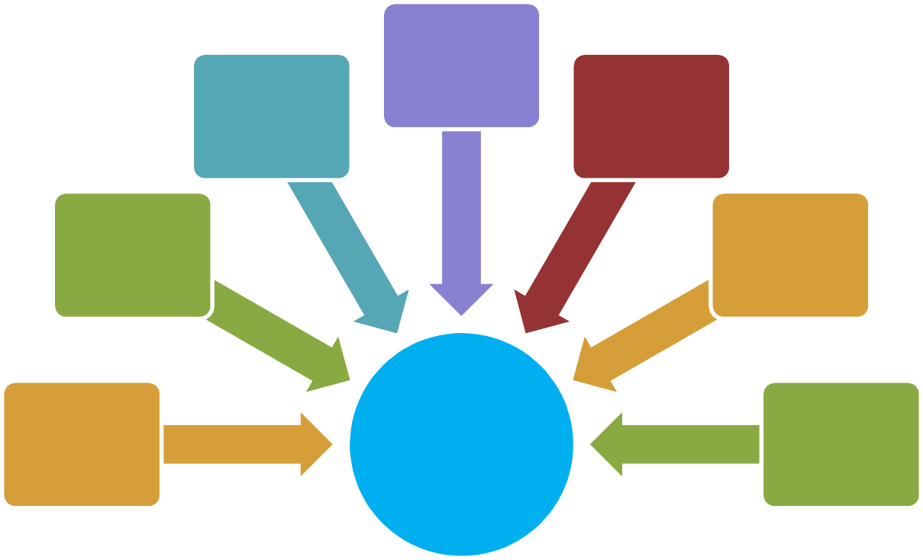
Why Mutual Funds?
Transparent
Economical
Diversification
Convenient
Manage Inflation
Professional
Benefits
High Returns

Slide 32
Systematic Investment Plan (SIP):
Equity Linked Savings Schemes (ELSS): Allows taxpayers to invest up to Rs.1.5 lakh in specific securities and claim it as a deduction from their taxable income.
Sovereign Gold Bond (SGB): These are government securities denominated in grams of gold. They are substitutes for holding physical gold.
Systematic Investment Plan is ideal for someone with a goal to accumulate funds for a future goal.
Systematic Withdrawal Plan is ideal for someone with a lump sum amount to invest for funding regular expenses.
Systematic Transfer Plan is when an investor invests a lump sum amount in a fund and regularly transfer a fixed/variable amount into another fund.
Sukanya Samrudhi Yojana (SSY)
SSY is a government-backed savings scheme for the benefit of the girl child. It can be opened by the parents of a girl child below the age of 10. Parents can open up to two such accounts for girls (they cannot open a third/fourth account etc., if they have more than two girls). These accounts have tenure of 21 years or until the girl child marries after the age of 18.

Slide 33
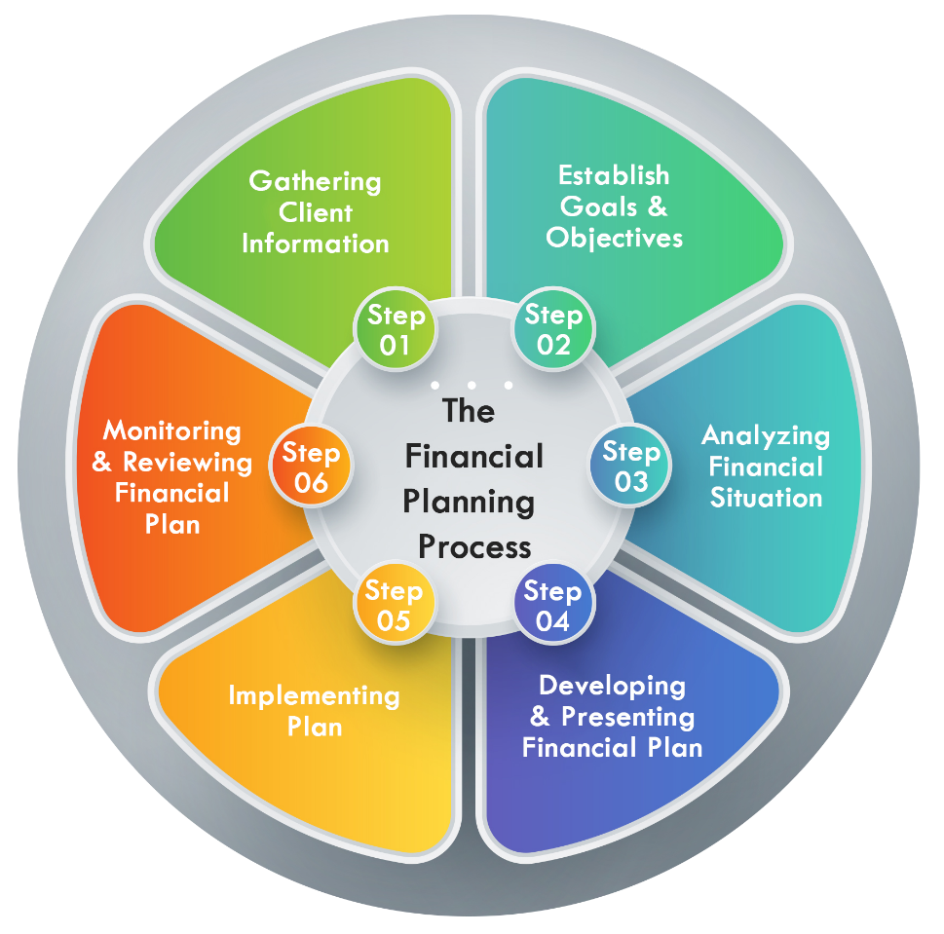
Financial Planning
Begin your financial planning by answering 3 questions:
Where am I now?
Where do I want to go?
How do I get from here to there?

Slide 34
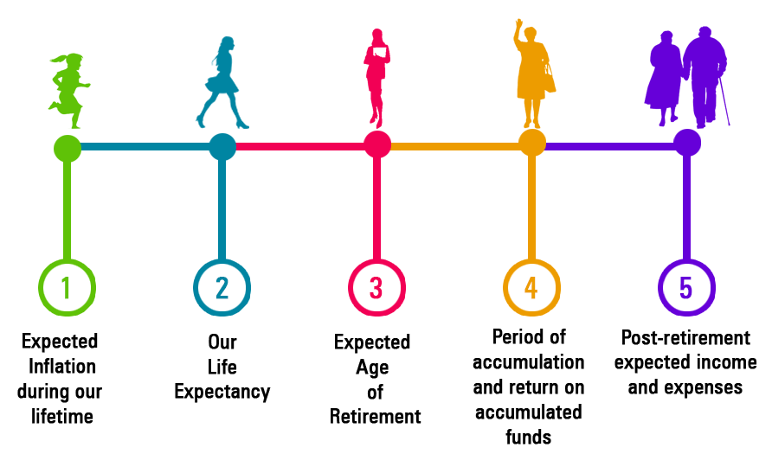
RETIREMENT AND PENSION
Points to keep in mind for Retirement Planning
Inflation affects your retirement needs in two ways.
The cost of goods that you buy increases which means for buying the same amount of good you need to pay more.
Due to inflation your retirement savings also lose value.
All this must be taken into account when you are creating your retirement fund.

Slide 35
National Pension System
It is open to all citizens of the country between the ages of 18 and 70 on a voluntary basis.
A minimum saving of 500 rupees per year is required to subscribe to the scheme.
When you retire, normally at age 60, you will get a part of your money and the remaining can be withdrawn on monthly basis. For more information visit https://www.pfrda.org.in

Slide 36
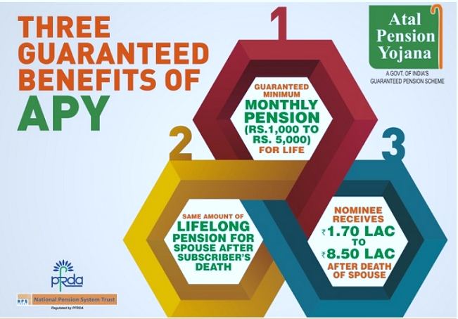
Atal Pension Yojana
Citizens of India between 18-40 years’ age group can join APY and will receive a guaranteed minimum pension of 1000 to 5000 rupees per month after the age of 60 years.
If you join the scheme early, say at the age of 18 years, you will need to pay only 42 rupees every month till the age of 60 to receive a guaranteed pension of 1000 rupees every month.

Slide 37
PENSION SCHEMES FOR VARIOUS TARGET GROUPS
Pradhan Mantri Shram Yogi Maan-dhan (PM-SYM) Yojana
PMLVMY (Pradhan Mantri Laghu Vyapari Maan-dhan Yojana )
Pradhan Mantri Kisan Maan Dhan Yojana (PMKMDY)
Voluntary and contributory pension scheme to ensure old age protection for Unorganized Workers, whose monthly income is Rs 15,000/ per month or less and belong to the entry age group of 18-40 years. Each subscriber under the PM-SYM, shall receive minimum assured pension of Rs 3000/- per month after attaining the age of 60 years.
Pension scheme to ensure old age protection for retailers and traders (self-employed workers). All shopkeepers and self-employed persons, as well as retail traders with GST turnover below Rs 1.5 crore and aged between 18-40 years, can enroll for the scheme. 50% monthly contribution is payable by the beneficiary and equal matching contribution is paid by the Central Government. Subscribers, after attaining the age of 60 years, are eligible for a monthly minimum assured pension of Rs.3,000/.
Pension scheme to ensure old age protection for all land holding Small and Marginal Farmers (SMFs) in the country. The scheme aims at providing a minimum assured pension of Rs 3000, to Small and Marginal Farmers (SMFs) in the country after attaining the age of 60 Years.
Notes:
This template was inserted from Power-user, the productivity add-in for PowerPoint, Excel and Word.
Install Power-user to access thousands of templates, icons, maps, diagrams and charts with Power-user.
Visit https://www.powerusersoftwares.com/
©Power-user SAS, terms of license: https://www.powerusersoftwares.com/terms

Slide 39
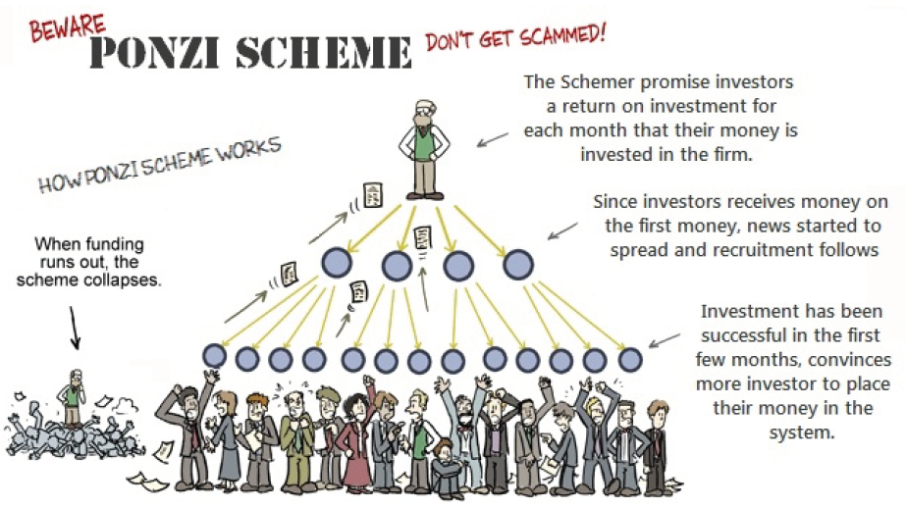
FRAUD PROTECTION AND GRIEVANCE REDRESSAL
Every year we hear new stories about people losing all their money by investing in illegal schemes. But this has not stopped others from falling prey to these schemes. This is because criminals are very .
Fraudsters and scamsters target people in a variety of ways: through email and on the telephone, when victims are making investments or by stealing personal information.

Slide 40
Types of Fraud or Scam

Slide 41
Protect Yourself from FRAUD

Slide 42
Protect Yourself from SCAMS

Slide 43
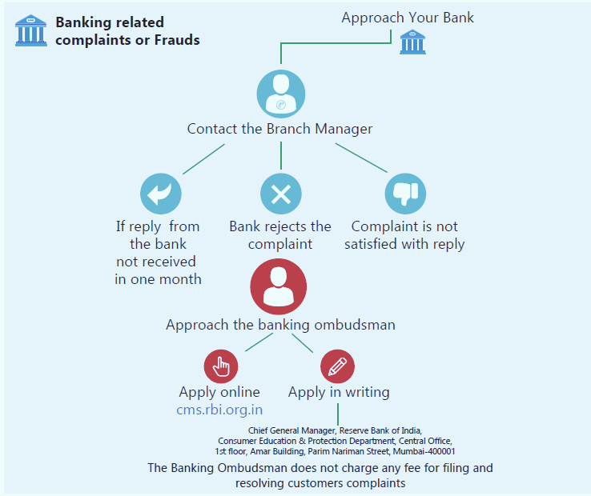
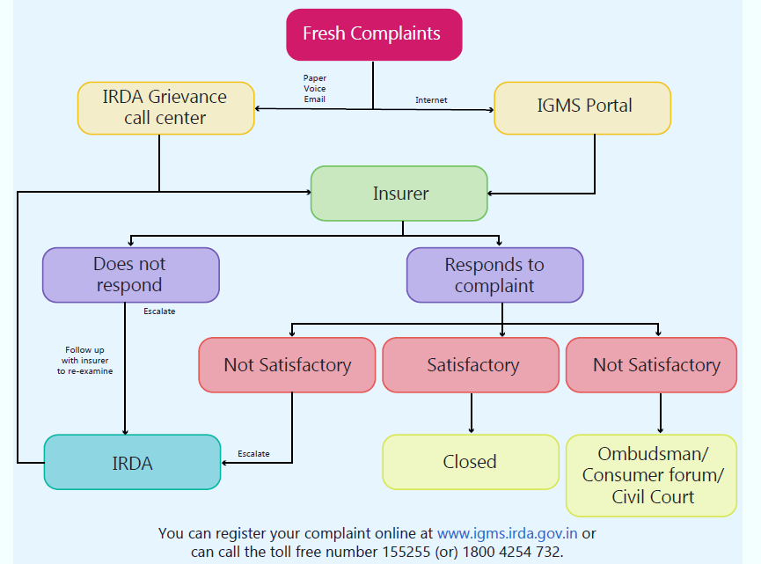
Grievance Redressal
Banking
Insurance

Slide 44
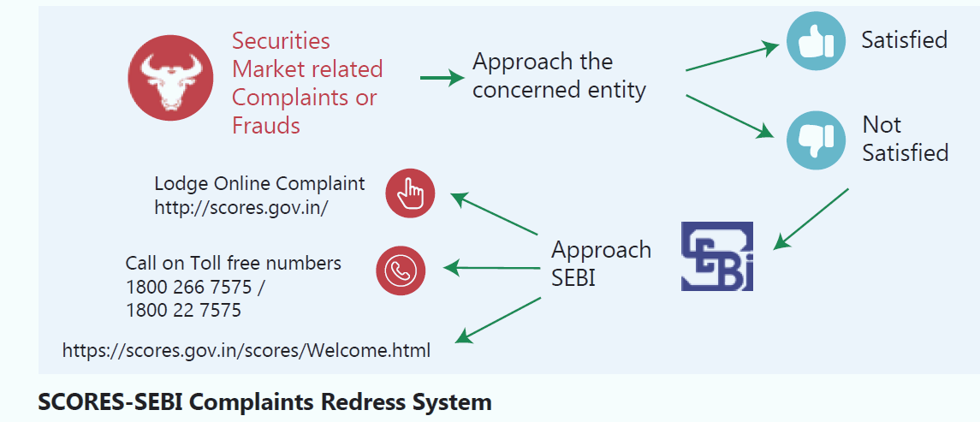
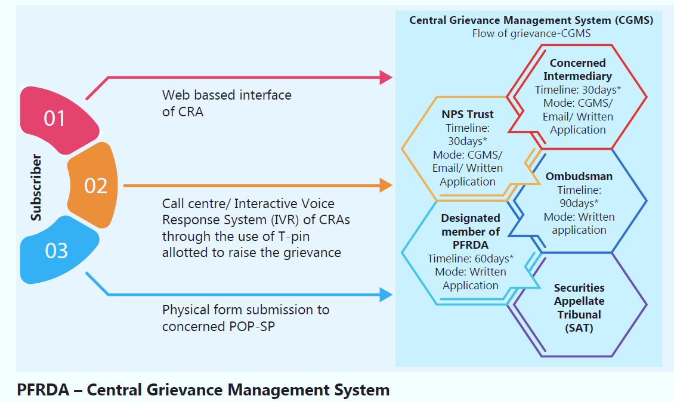
Investments
Pension

Slide 45
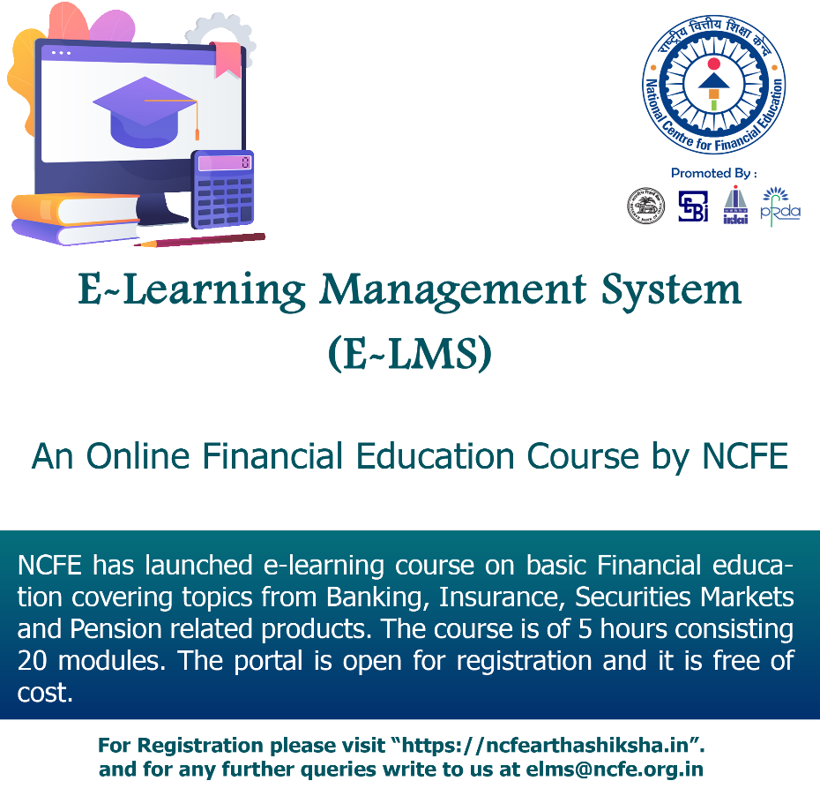
E – Learning Management System of NCFE
Free of cost to everyone
Topics from banking, insurance, securities markets, insurance and pension products
5 hours and 20 modules
Certificate after complementing the course
Anywhere anytime learning at own space
Mobile phone friendly
Use of audio visual for easy understanding
Link for sample video: https://ncfe.org.in/program/e-lms

